Slide 1
Women’s Role In The History Of Yoga
SEVA KAUR

Slide 2
RESEARCHERS: - Ramesh Bjonnes
- Vicki Noble
- Monica Sjoo
- Miranda Shaw - Book: Passionate Enlightenment
MYTH: WOMEN WERE NOT ALLOWED TO PRACTICE YOGA
From western yogis in America: Just from around 1960
Why that Myth? Maybe because they see Yoga as just the practice of HATHA
HATHA YOGA PRADIPIKA
Published in XV Century —> Western academicians think: Then, hatha yoga developed in the middle ages,
It contains 32 main yoga postures. Most essential.
Postures were developed by Shaiva Tantrics: Naked Hatha Yogis
Shaiva culture was already several thousand years old prior to · writing of the Hatha Yoga Pradipika (we know it from the Puranas)
So: yoga postures are thousands of years old as well.

Slide 3
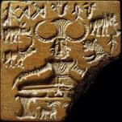
ARCHEOLOGICAL FINDINGS
SHIVA SEAL: Yogi in the Goraksasana position. Carbon dating: over 5000 yo. Not enough though.
YOGA SUTRAS OF PATANJALI: Uses the word “asanas” as seat of meditation. As lotus or half lotus position. There are no other asanas described there.
Easy to claim, as most yoga academicians do, that Hatha developed much later.
But Yoga Sutras is not a how-to book on practicing yoga postures. It’s a philosophical treatise on the 8 limbs of yoga.
Written around 200 BC.
No disclaimers in Yoga Sutras saying women can’t perform yoga.
YOGA IS NOT ONLY PHYSICAL POSTURES, But Meditation, chanting, praying, studying scriptures, ecstatic dances…

Slide 4
YOGA IS NOT ONLY PHYSICAL POSTURES,
But:
Meditation, chanting, praying,
studying scriptures, ecstatic dances…

Slide 5
ANOTHER REASON FOR THIS MYTH
India, like many other places, suffered and continues to suffer from sexism and racism
Women: treated like second class citizens for centuries.
Yoga is not the cause of this sexism. Men are the cause.
HISTORICALLY
India had two great influences:
TANTRIC: its sacredness supplied the esoteric + physical technology of yoga.
VEDIC: It didn’t do so.
YONI TANTRA
Written 500 yo. A classic literature of Shakta (a branch of the Tantra):
“In Kaula every woman is thought of as a manifestation of the Goddess.
No man may raise his hand, strike or threaten a woman.
When she is naked, men must kneel and worship her as the Goddess.
She has equal rights with men on all levels.”

Slide 6
VEDIC CULTURE - (1750 – 500 BCE)
Late Bronze Age and early Iron Age.
The end of the Indus Valley Civilisation.
Indo-Aryan Migration (1800-1500 BCE)
The Vedic Period refers to the time in history during which Indo-Aryans settled into northern India, bringing with them specific religious traditions.

Slide 7
Most history of this period is derived from the Vedas, the oldest scriptures in the Hindu religion, which were composed by the Aryans in Sanskrit.
When VEDAS were composed in the northern Indian subcontinent.
The oldest scriptures in Hinduism. In Sanskrit. Originates the Vedic Period.
Rig-Veda. A sacred Indo-Aryan collection of Vedic Sanskrit hymns.
It is counted among the four canonical sacred texts of Hinduism, known as the Vedas.
This period can be divided: Early Vedic (1750-1000 BCE) and Later Vedic (1000-500 BCE) periods

Slide 8
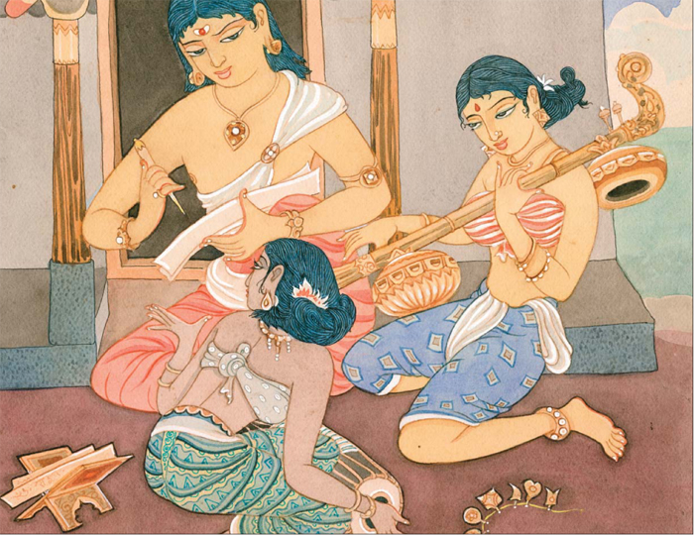
WOMEN IN EARLY VEDIC CULTURE
WOMEN OF VEDAS
27 Sages/Rishikis are in the Rigveda. Sages like: Lopamudra, Gargi, Maitreyi.
Women used to recite mantras in the rites.
GODDESES:
The feminine embodiment of important qualities and powers:
- Lakshmi (the goddess of fortune and queen of Lord Vishnu),
- Sarasvati (the goddess of learning),
- Subhadra (Krishna’s sister and auspiciousness personified),
Durga (the goddess of strength and power),
Kali (the power of time), and other Vedic goddesses that exemplify inner strength and divine attributes. Even divine power in the form of shakti is considered feminine.
Women was given the highest level of respect and freedom, protection and safety.
Vedic saying: “Where women are worshiped, there the gods dwell.”
“Where the women are happy, there will be prosperity”.
—> Other quotes can be found in other portions of the Vedic literature.

Slide 9
Women in Rig-Veda
The 126th hymn of the first book of the Rig-Veda was revealed by a Vedic woman: Romasha; the 179 hymn of the same book was by Lopamudra, another inspired Vedic woman. Others: Visvavara, Shashvati, Gargi, Maitreyi, Apala, Ghosha, and Aditi who instructed Indra, one of the Devas, in the higher knowledge of Brahman.
They lived the ideal life of spirituality, being untouched by the things of the world. They are called in Sanskrit Brahmavadinis, the speakers and revealers of Brahman.
Genuine Vedic Culture:
In early Vedic civilization women were always encouraged to pursue spiritual advancement without hindrance:
“O bride! May the knowledge of the Vedas be in front of you and behind you, in your centre and in your ends. May you conduct your life after attaining the knowledge of the Vedas. May you be benevolent, the harbinger of good fortune and health, and live in great dignity and indeed be illumined in your husband’s home.” (Atharva Veda, 14.1.64)

Slide 10
In ancient India the Sanskrit words used by the husband for the wife were:
Pathni (the one who leads the husband through life),
Dharmapathni (the one who guides the husband in dharma) and
Sahadharmacharini (one who moves with the husband on the path of dharma–righteousness and duty).
This is how ancient Vedic culture viewed the partnership of husband and wife.
“Where husband and wife get along well, Lakshmi Devi (goddess of fortune)
Herself dwells in that house”.
The Feminine Divinities
In the Vedic tradition it is common to see the pairing of the Vedic male Gods with a female counterpart, thus combining both sets of powers and qualities that each would have.
Radha-Krishna, Sita-Rama, Lakshmi-Vishnu, Uma-Mahesh, Durga-Shiva, Sarasvati-Brahma, Indrani-Indra, etc.
The combination of male and female Divinities make the complete balance in the divine spiritual powers.

Slide 11
Status of Women in the Epics:
Epic age, in the history of female freedom, may be regarded as a golden age.
Women had been accorded an honorable status in the society.
Women had an effective role in social and political life of the then society.
Most of the female characters of Ramayana and Mahabharata were well educated.
- The Ramayana illustrates the Hindu ideal women of India.
- Mahabharata with instances where women gave counsel/advice to men on social and religious issues.
Rig Veda
Some of the hymns in the history Rig Veda (Vedas as the source of all knowledge for Hindu, and Rig Veda is the most ancient), were penned by the rishikas, or the 27 women sages.
A woman who stood out among these learned women was Lopamudra, a seer who used music as her intellect and taught both men and women of those times.
Then a general survey of the Puranas reveals that the position of women declined in the corresponding age.

Slide 12
Foreign Invaders,
Unfortunately, these standards declined primarily due to the outside influences that have crept in because of foreign invaders, who dominated India, either militarily or culturally. They mostly looked at women as objects of sexual enjoyment and exploitation, and as the spoils of war to be taken like a prize.
Moghuls
The oppression of women increased in India because of Moghul rule.
Also the decay of the spiritual standards into Indian and Vedic culture.
The educational criteria of Vedic culture changed and the teaching of the divinity of motherhood was almost lost.
Competition replaced the pursuit for truth, and selfishness and possessiveness replaced the spirit of renunciation and detachment.
Gradually women were viewed as less divine, and more as objects of gratification or property to be possessed, controlled, or even exploited

Slide 13
Laws of Manu: Manava Dharma
The somewhat inclusiveness of women in the Early Vedic Era was replaced by a patriarchal brahminical era, which was expressed in the Laws of Manu, Manava Dharma.
The Rigidity of the caste system and the contemptible attitude toward women is unacceptable for today's standards.
The almost divine reverence shown to the Brahmin caste and the despicable attitude towards the 'Sudras' (the lowest caste), the attitude toward women in the Laws of Manu.
Women were considered inept, inconsistent, and sensual and were restrained from learning the Vedic texts or participating in meaningful social functions. Women were kept in abject subjugation all their lives.

Slide 14
MANU
Manu observes that the family, in which women suffer, is bound to be ruined, while the family in which women are happy is bound to prosper. He further enjoins that every person is to maintain peace with the female members of the household. He also advises every householder to treat his daughter as the highest object of tenderness and honour mother as the most venerable person in the world.
On the other hand we find a number of provisions in the Manu Smriti, which certainly go against her interests. Women are deprived of the Upanayana ceremony and thereby of education. Manu relegates her to an entirely subservient position. He preaches self-negation as the highest ideal of a wife. She is asked to serve and worship her husband even if he is not a person of all virtue and character. Since service and worship of the husband are the primary duties of a wife, by so performing she can hope to attain heaven.
Manu deprives women of her economic rights also. He says, “A wife, a son and a Slave, these three are declared to have no property, the wealth which they earn is for him to whom they belong”. He, calls her a ‘Pramada a temptress. He wants woman to be under the surveillance of father in her childhood, her husband in her youth and her sons after the death of her husband. He declares in unequivocal terms that no woman deserves independence.

Slide 15
Status of Women In Medieval Period
According to ancient Hindu texts and tradition, until about 500 B.C. women in India enjoyed considerable freedom. But during the next thousand years, women’s position gradually deteriorated. Educational and religious equality was denied to them. Widow remarriage was forbidden.
The status of women started degenerating in the post-Vedic age because of the conception of purity and pollution and restrictions of inter-caste marriages.
Child marriage had started in the Smriti age. During this period, a woman’s husband was regarded as God. During the middle ages, the position of women in Hindu society further degenerated. A number of problems arose for Hindu women in the Mughal period.

Slide 16
LATER VEDIC PERIOD
Indian Suppression of Women
Plenty of evidence of suppression of women in India.
Women were not able to read or study the scriptures, dance, practice yoga, etc. Women were not allowed to be Vedic priestesses in India.
(Brahmines)
Also, India has long been suffering from sexism, in large part due to · influence of Vedic dogmas.
These dogmas influenced the practice of yoga too.
That is why, most of the famous hatha yoga teachers coming out of India in recent years, have been men.

Slide 17
UPANISHADS + GITA
That happened when the Upanishads and the Gita were written down.
1000-500 years BC, which represents:
- the height of yogic literature and also a
- beautiful blending of Vedic thought and Tantric practice.
But most yoga scholars in the West claim that yoga has ancient Vedic origins. Not really true. That's why they claim yoga has not been practiced by women until very recently.
--> While the Vedic sacred stream has had a dismal track record in relation to women, Tantra has done a much better job.

Slide 18
Tantra And Shakti Traditions
Tantra and Shakti traditions have been relegated by history as magical and therefore not elaborated enough.
But, it was crucial to “revive the pre-patriarchal, pre-Brahminical values of feminine inclusion.” Tantra is reduced to ‘sexual practice’, but is in fact a demanding spiritual path that includes meditation, yoga, dance and elaborate circle rituals that evoke the ecstatic experience with the divine in and through the physical body.

Slide 19
TANTRA YOGA
7000 yo. Grew out of shamanism, WOMEN have been held in high regard.
Why?
Tantric culture: largely MATRIARCHAL.
Vedic society: patriarchal.
In Tantric culture, both men + women were TEACHERS.
In Vedic culture, only men were teachers.

Slide 20
WOMEN HAVE BEEN ALLOWED TO BE YOGINIS FOR THOUSANDS OF YEARS
The way out for women in Vedic society, was that they were allowed to be swamis, ochre clad holy women, or yoginis.
That tradition has been alive and well in India for thousands of years.
And, that tradition represents a mixture of Tantra and Veda.
Within · more genuine, non-Vedic culture, where Tantra (tantric yoga) was widely practiced, women have always been allowed to teach and practice as gurus, healers, yoginis, and Goddesses since · beginning of time.
There is NO evidence within traditional yogic or tantric culture that supports the myth that women were not allowed to practice yoga.

Slide 21
YOGINI?
If we consider a yogini to be someone only practicing yoga postures,
there are few such yoginis in Indian culture.
But hatha yoga is just one of many branches on the large tree of yoga.
If we also include the mystics who meditate, sing devotional songs, practice solitude, fasting, and other spiritual austerities, then there have been thousands, if not millions, of such yogini practitioners and gurus throughout the ages.
THE BAULS OF BENGAL
Ecstatic singers, dancers and meditators.
They wandered all over India since the Middle Ages.
Many of the Baul ecstatics are women.
Some of them became well known yoginis and gurus:
- Ananda Mai Ma,
- Arcanapuri Ma, and
- Laksmi Ma.

Slide 22
Ananda Mai Ma
Anandamai Ma, renowned yogini and guru from
the Baul tantric tradition in Bengal (19th century)
Mirabai
Celebrated poet, singer, and renowned Bhakti Yogi (ca. 14th century)
Sarada Devi
Bengali yogini and spiritual head of the Ramakrishna Mission after
her husband Ramakrishna’s death (19th century)
Kaoshitaki
Yogini, great scholar and wife of the celebrated yogi Maharishi Agastya, from South India (ca. early Middle Ages)
Karkati Rakshasi
Ayurvedic doctor and one of India’s first yogini surgeons, apprentice of Shiva (the King of Yoga (ca. 5000 BCE) (surgery was part of ancient Tantric Ayurvedic medicine but not practiced in areas were Vedic dogmas were dominant, due to caste prejudices)

Slide 23
WOMEN INVENTED YOGA!!!
Vicki Noble
Feminist historian,
She asserts that women INVENTED the ancient practice of Yoga.
Defies the common myth that women were not allowed to practice yoga until the past century.
Why are women still practicing a form of yoga developed by men – only for men?
In fact, her research is uncovering evidence of an alternative, much more ancient female centered yoga practice, that preceded the Vedic yogis by thousands of years
There are so many articles and books exploring the historical roots of yoga, and so few mention women’s contributions.
Why is it that the yoga scholars debating about the true historicity of yoga (is it 5000 years old or just 500) barely takes into account the legacy of ancient yoginis? I find this blind spot puzzling. I can’t help but wonder, in this so-called post feminist era, if yoga really has “come a long way baby”?

Slide 24
COMMUNAL YOGA-PRACTICE FROM PALEOLITHIC
Widespread female-centered communal yoga practice from the upper Paleolithic and Neolithic. (50.000-12000)
Celebrating the natural powers of “bleeding, birthing, healing and dying”.
Early yoga as rituals of trance and dance. [Shamanic - Sufi - …]
In this way disease was believed to be purged from the community and fertility in women, animals, and food crops enhanced.
Matrikas

Slide 25
ARTICRAFTS
Images of female Buddha’s and high-ranking shaman priestesses in the artifacts and figurines of Old Europe and Asia(6000 BCE).
Varied poses shown in these early sculptures, frescoes, murals, and rock art through the ages.
They are expressions of an ancient shamanistic yoga.
Eventually were codified into the formal schools we know today.
Women’s sculptures, seals, figurines
These cross-cultural sculptures, seals and figurines depict women in body postures startlingly similar to yoga asana.
Matrika/Mother Goddess, Mid-6th Century, India (Rajasthan, Tanesara)
Seated Goddess from Crete (c.5500 BCE)

Slide 26
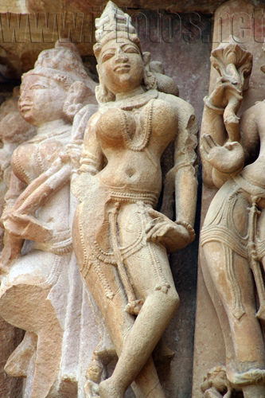
KUNDALINI
“Although such figures predate the formal codification of yoga in India by many thousands of years, each of them could be said to graphically depict steps of yoga that lead to “progressively deeper levels of awareness and functioning until, finally, ordinary consciousness is transcended in the bliss of ecstasy.”
The concept of raising Kundalini energy, so fundamental to yoga philosophy and practice, originated with these yogic priestesses.
“many prehistoric figurines show women merged with tree’s, w snakes coiling around their bodies, emerging from their heads.
Were these women raising · serpentine energy (kundalini) up · world tree (human spine) to achieve ‘wings’ or illuminated ccc (enlightenment)?
A Tantric Goddess LACMA

Slide 27
KUNDALINI
the concept of Kundalini originated in the female “Siddhis” (yogic powers) of menstruation, female sexuality, natural birth, and menopause.
Noble believes these ancient yogic rites encouraged the free, spontaneous flow of kundalini energy through the female group, and by extension, throughout the entire community.
Yoga scholars generally agree that the discovery of a seal in the Indus Valley (depicting a man seated in what we would now refer to as Lotus posture) is the first historical reference to yoga.
But there are many similar seals and figurines depicting women in ritual body postures – and many of them much older

Slide 28
Most of the figurines unearthed in the Indus Valley were female.
It is the Indian link from: - the matriarchal Paleolithic civilizations to
- the prehistory of yoga.”
Modern yoga is acknowledged to be largely derived from the Hatha tradition, but the roots of Hatha reach further to Tantra.
Scholar Ramesh Bjonnes writes” …if we talk about yoga as practice, as spiritual technology, its source is ancient, prehistoric Tantra, not the Vedas..
It seems compelling that YOGA emerged from Shamanism rather than from the priestly Vedic tradition, as most Western yoga scholars believe.”
And ancient prehistoric TANTRA dates back to the female centered shamanic practices of prehistory.
Harappa -2600-1900 BCE

Slide 29
Open-air stone temples still found in India where animal-headed statues of dancing women, stand as a reminder of these yogini’s ecstatic rites.
yogini’s gathered at feasts to play “cymbals, bells, and tambourines and danced within a halo of light and a cloud of incense.”
Yogini Temple Hirapur

Slide 30
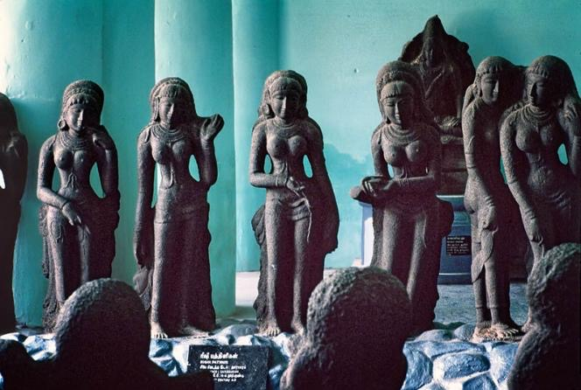
WOMEN CIRCLES
Within this nocturnal congregation, “a circle of yoginis feasted, performed rituals, taught, and inspired one another”. They sang “songs of realization” regaling one another “with spontaneous songs of deep spiritual insight.
The magical potency of Tantra was transmitted by a female line
“power-holders” – a mysterious sect of women called the Vratyas
Vratya, wandering ascetic ethnic group or a sect, who lived outside the fold of the dominant Vedic society.
They practiced their own forms of austerity and esoteric rites.
The Rigveda uses the term vratya about a dozen times, usually in reference to a breakaway group or an inimical horde of men living in temporary settlements.
Ancient Mothers (Sapta Matrikas), Tanjavore, Tamil Nadu

Slide 31
Taoist Yoginis from China and Dakinis from Tibet were also powerful spiritual teachers, giving empowerments and initiations.
FEMALE TANTRICS were called by many names:
- Dakinis (woman who flies)
- Vidyadharim (knowledge-holder)
- Vira (heroine) but the most common term was
- Yogini (keeper of the occult secrets).
So who were these women
And why do we know so little of their history today?
With the advance of patriarchy, the ecstatic techniques of women, were gradually swallowed up by the more ascetic practices of men.

Slide 32
In seated meditation, the transcendent was sought not through the body, but through the practices of mind.
Women and their biological functions came to be negatively equated with the life of the body and soon female rites were outlawed altogether. Yogini’s and dakini’s became “witches,” “ogresses,” “demonesses,” or “temple harlots”.
And over time we forgot there was once a different kind of yoga.
One in which the inherent powers of the female body were celebrated and harnessed for illumination, freedom and compassion – and the benefit of community.

Slide 33
SO, YOGA HAS HAD A FEMINIST HISTORY
Yoga has had some feminist history according to research but, like many other things, it too was completely forgotten due to the patriarchal takeover of yoga, by its gurus.
Women and their interest in yoga, devotion and spirituality, existed, but was not always legitimately accepted from the point of view of history.
So from much of ancient history, except for the few stones discovered with women in yoga and tantric poses, there was hardly anything recorded about women’s contribution to the practise.
Taking the basis of the Upanishads: if Yoga is a method of gaining liberation from the bonds of this world (moksha) then there are many ‘wise’ women part of it.
These wise women practised different ways to connect with their body and the divine.

Slide 34
GARGI
She debates with the wise Yajñavalkya (Hindu Vedic sage) and almost defeats him, but is being silenced instead.
Gargi Vachaknavi (born about 9th to 7th century BCE) was an ancient Indian philosopher.
She was the daughter of sage Vachaknu. In Vedic literature, she is honored as a great natural philosopher, renowned expounder of the Vedas, and known as Brahmavadini, a person with knowledge of Brahma Vidya.
From a young age she evinced keen interest in Vedic scriptures and became very proficient in philosophy.
She became highly knowledgeable in the Vedas and Upanishads in the Vedic times.
She also held intellectual debates with other philosophers.
In the Sixth and the eighth Brahmana of Brihadaranyaka Upanishad, she participates in the brahmayajna, a philosophic debate organized by King Janaka of Videha and she challenges the sage Yajnavalkya with perplexing questions on the issue of atman (soul). She has also written many hymns in the Rigveda.

Slide 35
MITREYI
the wife of Yajñavalkya, is said to be a knower of God and is interested in spiritual knowledge above all other things.
Poetisa de la antigua India.
Segunda esposa del famoso sabio Iagñavalkia, que ya estaba casado con Katiaiani.¹
Maitrei no quería casarse con Iagña Valkia, sino vivir con él como su discípula y compañía espiritual para realizar sadhana o prácticas espirituales.
Se acercó a Katiaiani para expresarle su deseo de vivir con ellos.
La sabia accedió y le otorgó su consentimiento.
Maitrei era versada en el conocimiento védico.
Sus contemporáneos la consideraron una brahmavadi (‘[que cree en la] doctrina del Brahman’).²
Se le atribuyen unos diez himnos del Rig-veda (el texto más antiguo de la India, de mediados del II milenio a. C.)³ ¹

Slide 36
SULABHA,
She argues with king JANAKA that women are also able to achieve liberation like as men.
And regarding their true soul, atman , there is not a real difference between men and women.
This essay highlights the debate on women and gender in ancient Indian texts. Neither the popular nor the scholarly debate in modern India has paid sufficient attention to unmarried learned women in ancient Hindu texts.
Sulabha, a single woman and an intellectual-renunciant; with her debate with philosopher-king Janaka in the epic Mahabharata.
Janaka uses anti-women arguments to critique Sulabha's unconventional behavior, Sulabha successfully establishes, on the basis of Hindu philosophical principles, that there is no essential difference between a man and a woman.
She also demonstrates by her own example that a woman may achieve liberation by the same means as a man. In the same epic, a married woman wins her debate with a male sage, proving that even a woman following the conventional path of wifely devotion may equal or outdo a sage in wisdom and virtue.

Slide 37
INDRA DEVI
So how did we get to to the yoga of today?
Mysore, India. The woman is a stubborn and ambitious young newlywed, known by her stage name Indra Devi, a rising star in Indian films. Her husband, Jan Strakaty, connects her to the Maharaja and Maharini of Mysore (i.e. the ruling/royal family) who are sponsoring a yoga school led by Sri Krishnamacharya.
This school teaches boys from a young age to master all aspects of yoga, including the poses (asanas). It was no easy task, but Indra Devi convinced the guru to take her on as his first female (and Western) student.
She toughed it out with the boys, so to speak.
She went on to master the practice and launch its westward journey.

Slide 38
She was among other modern yoga leaders like B.K.S. Iyengar and Pattabhi Jois, also working to make yoga more accessible to the masses and help it move to new frontiers.
Devi was fluent in multiple languages, which became a powerful tool in spreading yoga’s messages and lessons.
She started her first teachings in Shanghai and then moved on to the United States — leading classes in Hollywood, no less.
Simultaneously, her fellow yoga disciples had made a name for themselves.
The trio made their mark on the Western world and suddenly yoga was a household-friendly workout. Even during the yoga movement’s progression, Devi remained outnumbered by her male teachers.

Slide 39
GURU NAANAK DEV JI
“From woman, man is born;
within woman, man is conceived; to woman he is engaged and married.
Woman becomes his friend; through woman, the future generations come.
When his woman dies, he seeks another woman; to woman he is bound.
So why call her bad? From her, kings are born.
From woman, woman is born; without woman, there would be no one at all.
For Sikhs from that period, there has been compulsion to treat women as equals (KAUR).
Gender discrimination was not allowed. However, high principles set by prophets and religious leaders have always been very difficult to implement and put into practise.
In Sikhism, the Holy Scriptures have clearly stated that the Sikh woman has always been regarded as an equal with man and has all the rights and privileges enjoyed by a man.
She is considered to have the same soul as man and has equal right to grow spiritually.
She is allowed to lead religious congregations, to take part in Akhand Path (the continuous recitation of the Holy Scriptures), to perform Kirtan, to work as Granthi (priest) or a preacher and to participate freely in all religious, cultural, social, political and secular activities.

Slide 40
Bebe Nanki had a very good and cordial relation with her sister in law, Mata Sulakhni, and helped her in bringing up her sons, Sri Chand and Lakhmi Chand. She rather adopted Sri Chand as she herself was issueless.

