Slide 1
HISTORY OF YOGA
FROM 35OO BCE TO AQUARIAN AGE 2011 AND ONWARDS
Why study ‘History of Yoga’? To set a framework to put into place the earliest beginnings of Yoga, that we know about, until present times. This will give you a wider picture as to how it developed, evolved and how it fits in with the ‘spiritual’ practice of Yoga today.

Slide 2
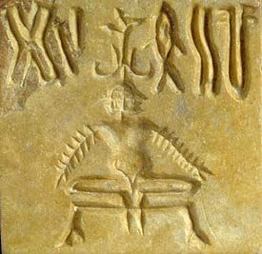
INDUS VALLEY CIVILIZATION 3500-1500 BCE
The initial development of yoga can be traced to over 5,000 years ago, thanks to evidence of yoga poses found on stone drawings. Archaeological findings from the Indus Valley Civilization revealed a portrait of a Yogi meditating in what looks like an asana. The Indus Valley Civilization has also been attributed to indirectly give rise to Buddhism and Jainism as well. There wasn’t any written evidence of Yoga in early times, it was passed on from teacher to student in oral tradition.

Slide 3
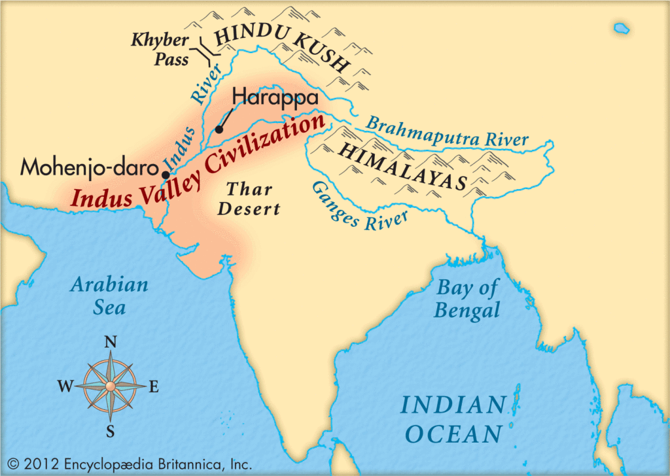

Slide 4
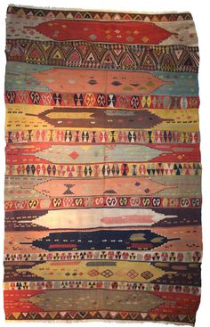
The inheritance of Yoga is woven like a tapestry with the wisdom and practices of generations of explorers of the human spirit. ‘A Spiritual Quest of Yoga & Indian Philosophy’. That same quest or longing to make sense of our needs, hopes and who we truly are is the same today as it was 1,000s of years ago.

Slide 5
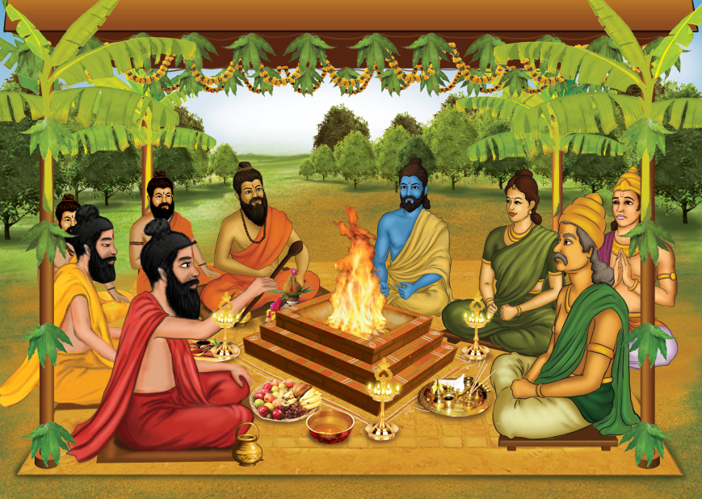
Rishi term for an accomplished and enlightened person. They find mentions in various Hindu Vedic texts. Rishis are believed to have composed hymns of the Vedas. Wikipedia
VEDIC PERIOD 1500-500 BCE
Rishi (seer) term for an accomplished and enlightened person. They find mentions in various Hindu Vedic texts. Rishis are believed to have composed hymns of the Vedas.

Slide 6
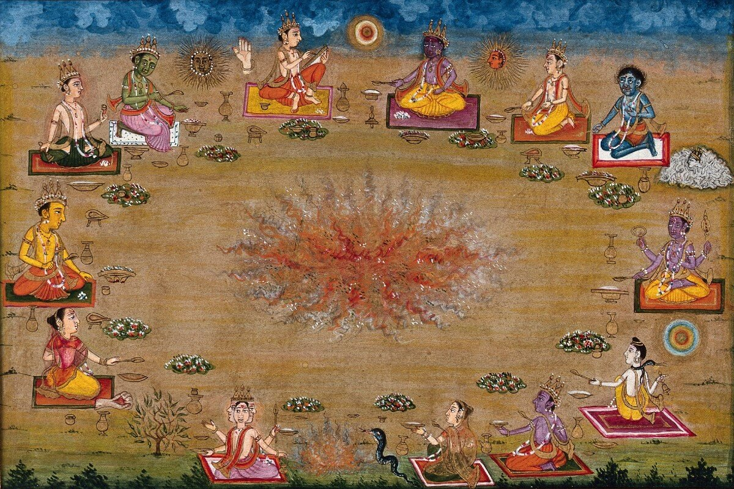
VEDIC PERIOD (1500-500 BCE)
The rishis, or spiritual seers, developed and practiced concentration techniques to quiet their minds and hear the unspoken or revealed sounds (sruti). They discovered that by quieting the mind they could open the doors of perception, and gain subtle knowledge about the cosmos.
They spoke Sanskrit, an Indo-European language in which the Vedas were spoken and eventually written.
Interesting to note the rishis are the ones who conceived who held the universe together and could only be experienced through the cosmic sacred sound or word, later referred to as Shabad Brahman and Naad Brahman in the Upanishads!

Slide 7
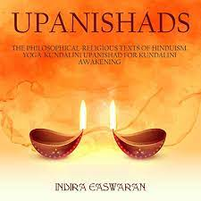
UPANISHADIC PERIOD (800-500 BCE)
The Pre-Classical Yoga period covers an extensive period of approximately 2,000 years. The 108 Upanishads evolve from Vedic thought into philosophical and internalized ritual sacrifice of the ego for self-liberation from the karmic cycle of death rebirth (samsara).
These are ecstatic writings full of technology of self-realization and liberation.

Slide 8

From ignorance, lead me to truth;
From darkness, lead me to light;
From death, lead me to immortality
Om peace, peace, peace!
The great King Janaka transmitted knowledge of Raj Yoga and Kundalini Yoga. There were many enlightened sages.
Upanishads Chant

Slide 9
YOGA-KUNDALINI UPANISHAD (1100-1800 CE)
Yoga-Kundalini Upanishad is a short Yoga Upanishad on how to
Awaken the Kundalini. Examples:
Chapter 1: Raising the Kundalini-physiology and discipline: prana, diet, asana, retention of breath; the three body locks: mula-bandh, uddiyana-bandh, jalandar-bandh, merging apana-prana-agni, awakening the kundalini, amrit nectar, the union of Kundalini, the pranic body, removing the veil of illusion, the Kundalini rising, 3 granthis—(psychic knots) obstacles/blockages and chakras on the path to awaken kundalini.
Chapter 2: curling the tip of the tongue back to the soft palate (kechar mudra) to raise the Kundalini and access the amrit nectar.
Chapter 3: How to maintain a sadhana, ……

Slide 10
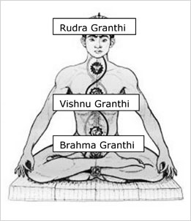
Brahma granthi functions in the region of mooladhara chakra. It implies attachment to physical pleasures, material objects and excessive selfishness. It also implies the ensnaring power of tamas - negativity, lethargy and ignorance.
Vishnu granthi operates in the region of anahata chakra. It is associated with the bondage of emotional attachment and attachment to people and inner psychic visions. It is connected with rajas - the tendency towards passion, ambition and assertiveness.
Rudra granthi functions in the region of ajna chakra. It is associated with attachment to siddhis, psychic phenomena and the concept of ourselves as individuals. One must surrender the sense of individual ego and transcend duality to make further spiritual progress.

Slide 11
EPIC PERIOD (800-300 BCE): Movement toward systemization of the
Inner technology. The Ramayana teaches of Divine Love and self-transformation; the Bhagavad Gita the path of dharma, and karma yoga.
CLASSICAL PERIOD (300 BCE-500 CE): A period of dualism. Renowned philosophers of this era: Samkhya & Pantanjali’s Yoga Sutras. In this period the six schools of thought and the technologies of yoga were systemized. One of the most important philosophers of this time was Patanjali (about 200 CE) – the Yoga Sutras of Patanjali. Patanjali compiled and systemitized the yogic philosophy from various traditions into easily memorizable sutra form. Notably: ‘The Eight Limbs of Yoga’. (see the next slide)
POST-CLASSICAL PERIOD (500 CE-1700 CE): Development of practices and philosophies, part of kundalini yoga including Tantra, Advaita Vedanta, Hatha Yoga, and Bhakti Yoga. They began to probe the hidden powers of the body through asana, mudra and kriya – rejuvenate the body and prolong life. The Yoga-Upanishads developed during the latter part of this period and Yoga Kundalini.
Guru Nanak (1500 CE) the first Sikh Guru is mentioned as he interacted with Goraknath, a leading Yogi.
NOTE THE SIX SCHOOLS OF YOGA:
Hatha Yoga- or yoga of postures
Raja Yoga- or yoga of self-control
Kundalini Yoga- yoga of energy
Karma Yoga- yoga of mind
Jnana yoga-yoga of knowledge
Bhakti yoga- Yoga of devotion

Slide 12
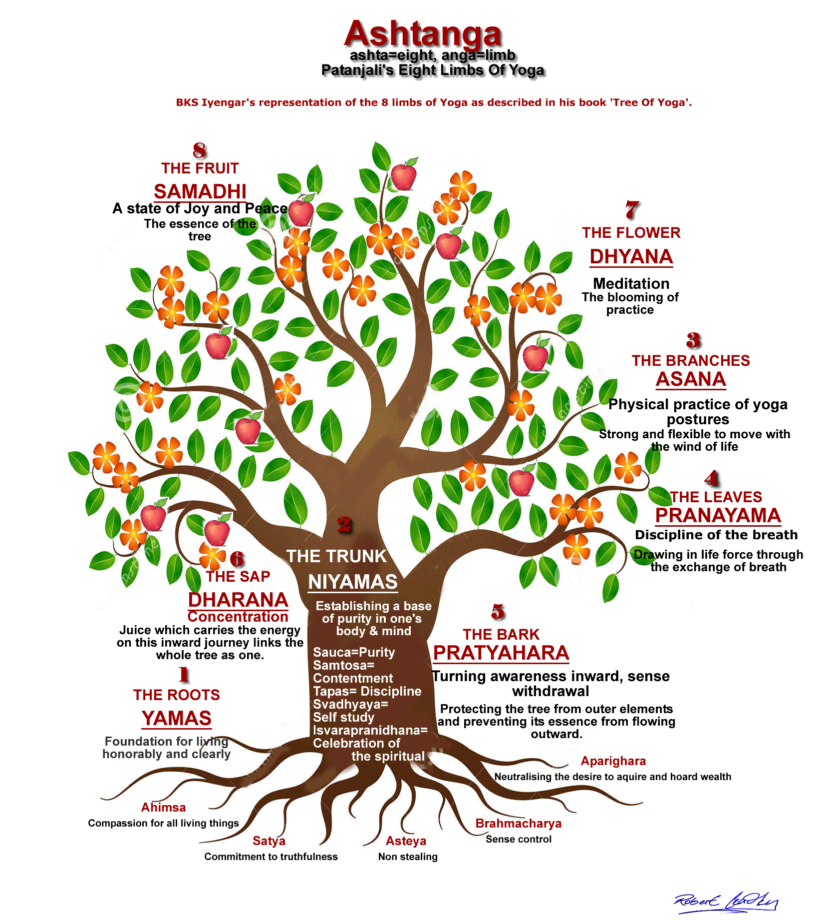

Slide 13
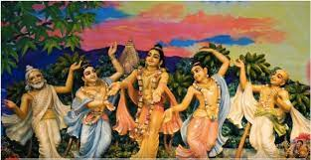
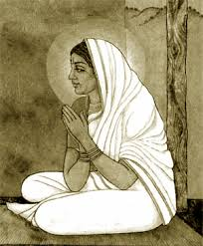
BHAKTI MOVEMENT (1100-1700): Emphasizes mystical union through loving devotion.
Bhakti (loving devotion) offered a direct experience of mystical union with the divine manifest in form and union with the formless Divine through repetition (japa) and chanting mantra of poetic song (bani). Influence of the devotional Sufi-Islamic poets such as Rumi and Hafiz 13th – 14th c. migrated to India, merging with Krishna Bhakti tradtion.
This great confluence gave birth to poetic sant-mystics such as Kabir, Ravidas, Namdev, Nanak, and others!

Slide 14
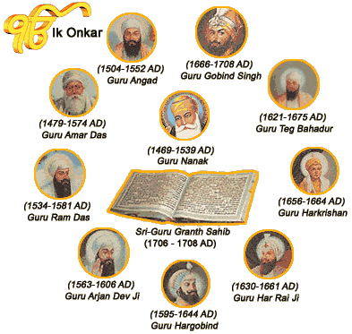
SIKH GURU ERA (1469-1708 CE): Ten Sikh Gurus synthesize the practices of the Renunciate Sage into a householder tradition of the Warrior Saint. They critique and actively dismantle caste structures, ritual dogmatism, religious fanaticism, inequality, and ego-based politics. Guru Nanak, the first Sikh Guru divinely composed the Mul Mantra. The Sikh Gurus emphasized non-attachment, proclaiming the formless Creator and manifest Creation are One, and this reality is our true identity, Ek Ong Kar Sat Nam.

Slide 15
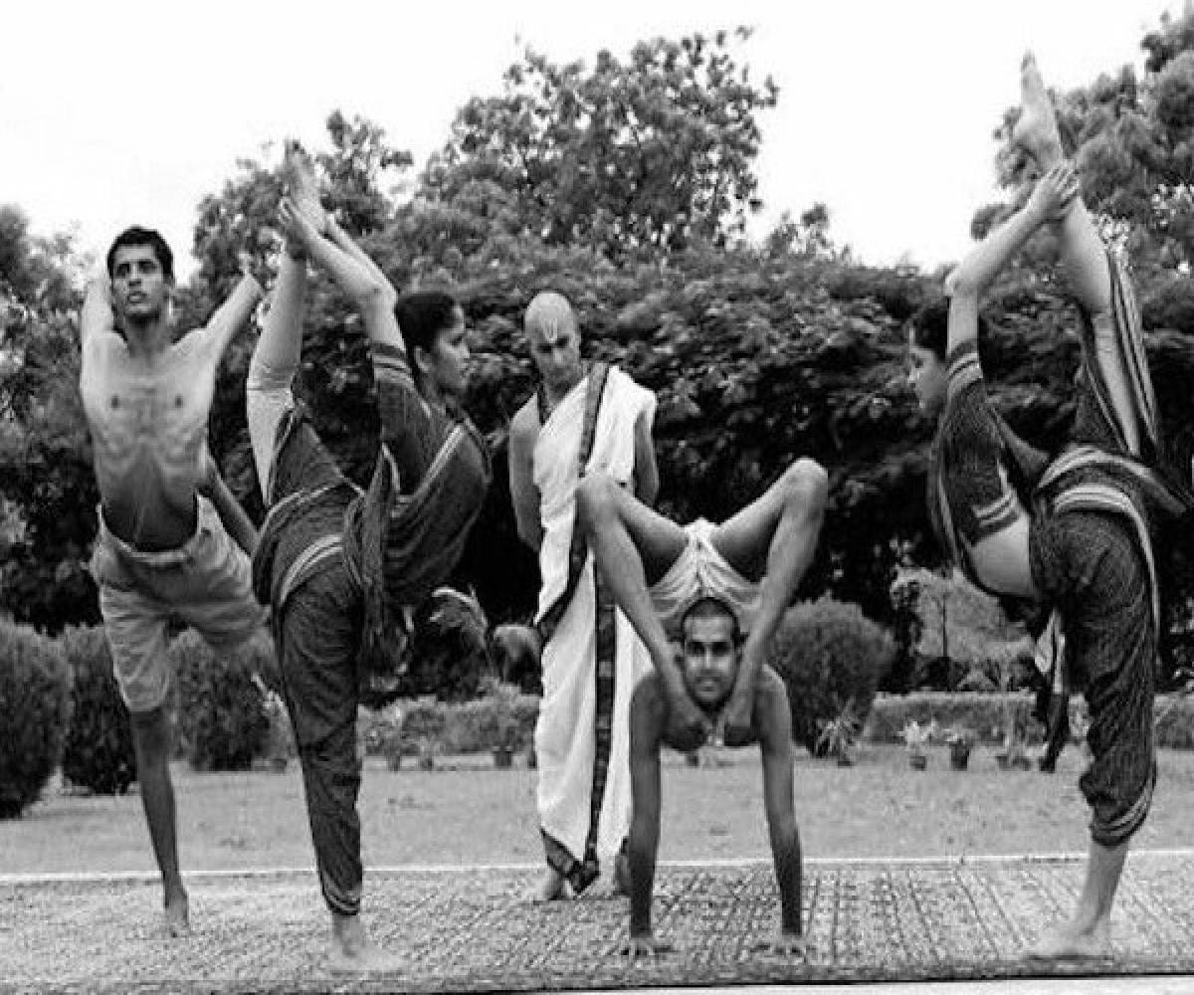
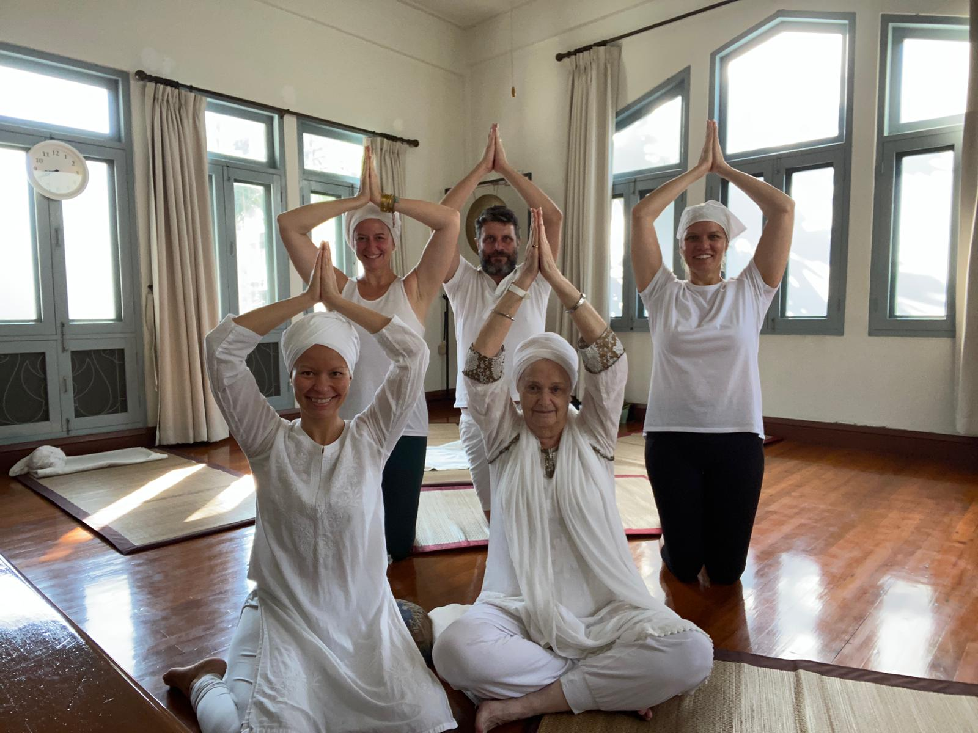
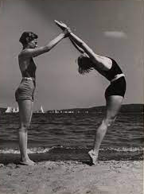
MODERN PERIOD (1700 and beyond): A period of European expansion, colonization, reform and the syncretic-merging of different traditions, formation of new styles of yoga. Modern yoga began during this period. Schools of Yoga practiced today come from the Guru-lineages developed during this period, such as Astanga, Vinyasa, Iyengar, Kripalu, Bikram, and Kundalini Yoga as taught by Yogi Bhajan.

Slide 16
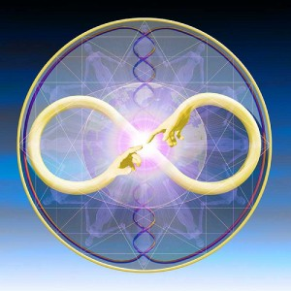
AQUARIAN AGE (2011 CE-onwards)
A period based on experience, commitment, and universality, ushering
In a new level of consciousness! The key term for this Age is
globalization, universality, transparency and the dignity of the human
being. The need is to establish an authentic transformative experience
In each individual so they may serve the well-being of the global
Community. Consciousness and its many levels will be the theme in this
Age!

