Slide 1
Intro to Mind & Meditation
Notes:
Why should we meditate? Because we want a clear Mind to see our own soul. We can achieve success, happiness, and prosperity by mastering the mind. When we align our mind with the soul, we can feel more clarity and feel more fulfilled. But our mind can be clouded by unconscious thoughts and emotions, which lead to false judgments, and we feel unhappy.
Inside each of us lives the divine essence, Purusha, untouched by pain, suffering or desires, while Maya is the illusion of separateness created by the mind. Yoga helps control the mind's thought waves, so we can see our true nature. Through meditation, we connect with our innermost self align our mind with our soul and experience pure consciousness.
Silence awakens you to what is in the subconscious.
Mantra transforms the content of the subconsciousness.
Merger through rhythm and naad takes you into anahat,
the Unstruck Sound the silence of the ego which changes the structure of the consciousness itself.

Slide 2
Notes:
SEATING YOURSELF FOR MEDITATION – PG 134
When -anytime which is peaceful.
Best is early morning time 2 ½ hrs before the dawn when all is quiet. Or when the sun is setting. Or before going to sleep so you can settle and clear your mind so you can have a deep sleep.
It’s best to not have a full stomach when meditating. So if we have a practice of getting up early for our sadhana or before bed we want to have a light meal for dinner or supper. And a larger meal mid day.
We want to wear comfortable clothing and cover our heads. (try it both ways). The fabrics should be made with natural fibers.
Set yourself a place where you feel comfortable & cozy. Without distractions, not too hot or cold.
Could set up an alter
We sit on a sheep skin. This will help to reflect our own energy back to us. So not only is nothing lost, our energy is amplified.
We tune in with the Adi Mantra,
Do our practice - Which is usually a kundalini yoga kriya & breathing exercises to prepare for meditation.
This helps to balance the nervous system and the stimulation of the more subtle energies of the mind and body and will help facilitate the process of meditation.
Then we rest in savasana.
We come up and prepare ourselves for meditation.
Wrap a shawl or blanket over your shoulders to keep warm if needed.
Your spine should be straight. In some cases as a teacher you may recommend a student use a chair or on the floor a cushion can be used to allow ease in having a straight spine. We want a straight spine because it acts as a central channel for the energy of the nervous system.
We want to have our chins slightly down and in. This is called Neck Lock.
We begin to slow our breath, scan our body for any tension and let it go as we exhale. Silently vibrating the word Sat as we Inhale and exhaling Nam. Now we are ready to start the meditation of choice.
As you sit and turn your focus inward, you’ll become aware of a lot of thoughts will start come in, thoughts you may not want. Just keep bringing yourself back to the mantra or the focal point. Don’t overthink about it. Just bring yourself back The mind generates thousands of thoughts per second. If you stay gentle with yourself, let them come and pass by, They will be processed by the mantra. Practice staying still, If you physically don’t move your mind will become still. Your mind never stops, but you can create a stillness, a calm which will serve you all your life.
When your mind becomes still, that is the foundation or the beginning of meditative mind. Purely a physical process. When your mind becomes still you will feel cozy. And it is indescribable. And you will want to do it often because of this comfortable feeling. At 1st it will be short, maybe only a minute or 2 of fully focused meditation, but as you develop with practice the time it takes you to reach the coziness will be shorter & shorter. .
The meditating at the end of a yoga set is the true completion of the process of KY. It dedicates the energies of the mind, body and soul to their true state of transcendence and grace.
In Kundalini Yoga, various types of meditations exist, each serving different purposes such as creativity, energy, peace, character, and healing. Some focus on breath awareness, while others involve chanting mantras or doing specific body postures. These elements work together to influence your psyche in specific ways. Every meditation, regardless of its focus, aims to provide you with an experience of universal truth when practiced correctly.

Slide 3
Gong
Ad Gurey
Jugad Gurey
Sat Gurey Nameh
Siri Guru Dev A Nameh
Ong Namo
Guru Dev Namo
Ad Such
Jugad Such
Haibhee Such
Nanak Hosee Bhee Such
The Art of the Gong in Kundalini Yoga Meditation
Notes:
TYPES – PAGE 136
Sound (Gong) “The gong is a beautiful reinforced vibration. It is like a multitude of strings, as if you played with a million strings. The gong is the only tool with which you can produce this combination of space vibrations.” (Women in Training - 1984, 7/5/84)
The player of the gong links himself and attunes his mind to the power of the original
sound current.
To do this and link our mind & subtle body is to give a prayer.
The prayer can be done internally or out loud and has three steps to it.
You complete each step by reciting a mantra and each mantra relates to a different level of your being.
The three mantras in sequence are:
Mangala Charan -Aad Guray Nameh (It invokes the mind to
bow before the teacher and to accept the world as a teaching and a blessing. This mantra helps you become peaceful and centered. It’s a mental
projection of devotion and acceptance of the gift of life and an appreciation of this moment of
opportunity where you may play the gong.
Adi Mantra -Ong Namo (Allows the chanter to connect instantly to the divine teacher within)
Ad Such Jugad Such Habay such naanak hose bay such (Gets anything that’s stuck moving)
The first mantra starts at the earth within the realms of ordinary experience. The third takes you
to the threshold of the realm of being itself. If you recite these mantras as prayers, with devotion
and willingness to put your own ego aside, then you are lifted to the point of Infinity. That is the
place from which to play the gong. Let yourself be an instrument for the flow of consciousness.
Blend yourself into the energy and qualities of the sound of the gong. Now in this state, the gong
becomes a divine instrument.
In this state you won’t allow your ego to take over. Wondering if they like it.
How do you sound, Oh I’m so good at the gong!!
In this state you’ll be playing from the position of Infinity and you can serve the consciousness in the students.
You can act from duty and from the ecstasy of the sound current.
You’ll play with the attitude of seva – being of service without needing recognition or thanks.
The mantras project you into that internal position. Then the impact of the sound consolidates and expands that initial internal state.

Slide 4
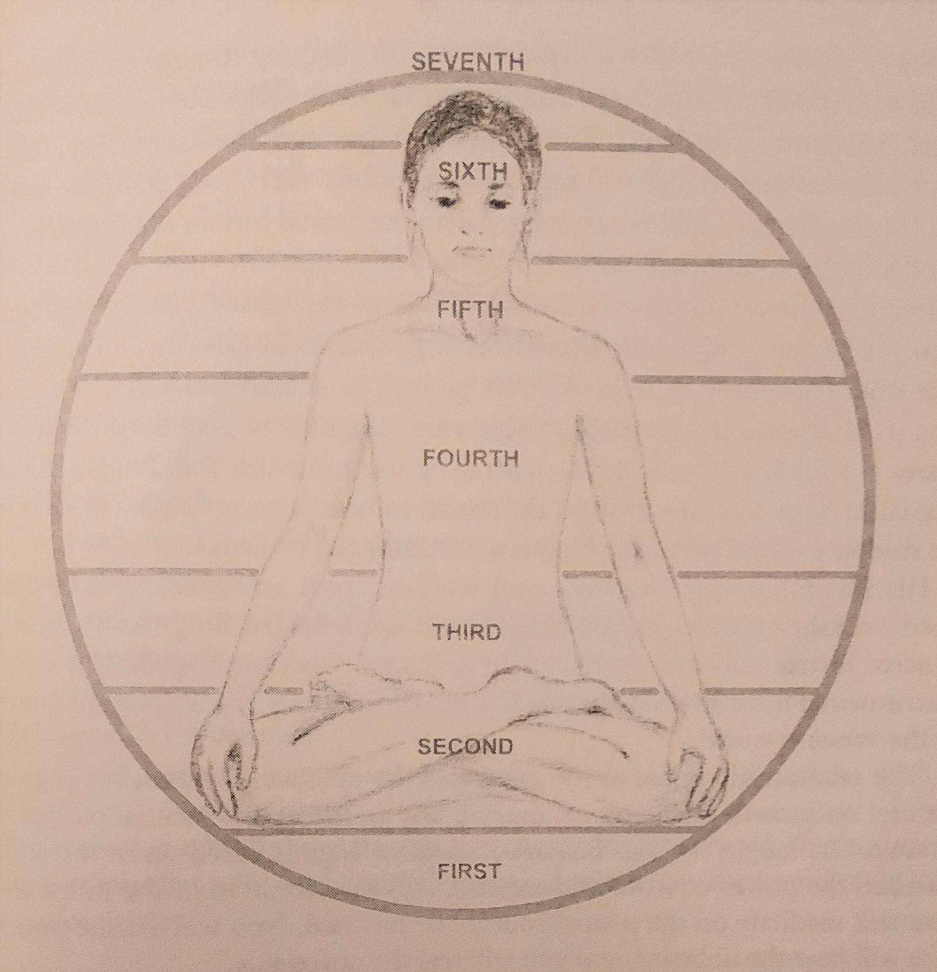
Notes:
Sometimes its played during a meditation. Usually played during savasana. Feet are facing the gong. We remind our students to completely relax and surrender to the sound. Students may feel irritated and thoughts and feelings, emotions may come up, Surrender.
The sound of the gong projects to all the chakras and can be used as a powerful instrument to open and balance them.
It can also enliven and integrate the 10 bodies of the aura. Certain areas on the gong relate to different chakras. The relationship of the points to each other as well as the type of sound produced by rhythmically striking that area determine the impact of these points. The points played in combination create an impact that is like the complex patterns of a many faceted orchestra.
So as a teacher the gong can be a great tool when you’re working on the 10 bodies or the chakras.
Mallets Larger, Heavier deeper sound. Smaller Lighter Higher sounds.

Slide 5
Celestial Communication
Notes:
Celestial Communication
This type of Meditation is good to share at the end of a class or at a workshop or event.
is a powerful moving meditation set to music, designed to activate the pranic energy in the Heart Center.
It helps reclaim the body, integrate the brain, and relax inner stress.
By engaging in this practice, stress and trauma can be transformed into new understanding through movement.
Many can relate to it, it’s common to move our bodies.
The gentle movements with music & mudras relax tension in the brain and wake up our intuition.
We’re not supposed to change or mix up Kundalini Yoga kriyas, but Celestial Communication allows for you to use your own expression and alignment of body, mind, and feelings with the music or mantra.
The goal is to embody your original Self and express all emotions within.
For this we want to choose uplifting music, move in rhythm with intention, use hands and fingers consciously, and be aware of your body.
You’ll want to include moving opposite sides of the body, so there are varying movements in polarities, and using different speeds in sync with the rhythm.
Each movement and sequence should be intentional and projected outward.

Slide 6
Malas
Index finger (Jupiter)
wisdom, knowledge, and prosperity.
Middle finger (Saturn)
enhances patience.
Ring finger (Sun)
promotes health, vitality,
and strengthens the nervous system.
Little finger (Mercury)
communication skills, and intelligence.
Notes:
Malas
Beautiful! We love to wear them!
A mala is simple, & effective to use as a meditative tool,
It can help to reduce stress and enhance wisdom, patience, and health.
A mala consists of 108, 54, or 27 beads, traditionally strung on silk thread with one larger bead, called the Guru bead, from which a tassel hangs.
The tassel symbolizes a thousand lotus petals.
Each finger you use, while meditating with the help of the mala, relates to a different part of the brain.
When you move the mala over the meridian point of the desired finger, you create a different result.
The meridian point is located on the side of each finger, between the tip of the finger and the first knuckle:
Index finger (Jupiter): wisdom, knowledge, and prosperity.
Middle finger (Saturn): enhances patience.
Ring finger (Sun): promotes health, vitality, and strengthens the nervous system.
Little finger (Mercury): communication skill, and intelligence.
You can use your mala with either hand.
Always start with the bead next to the Guru bead. As you repeat the mantra, move each bead with the thumb, towards the body over the meridian point.
Pulling it toward you so the Guru bead descends until you once again reach the Guru Bead. As you hold the Guru bead, repeat your mantra.
To begin again turn the mala around without the help of the other hand. Move the beads towards you and continue your mantra.
For instance if your reciting the mantra SAT NAAM move only one bead for both words.
Or With the mantra WHA-HAY GUROO, move only one bead for the two words.
Or if you use the mantra SAT NAAM WHA-HAY GUROO, saying them both with the movement of one bead.
Of course You can use any affirmation or mantra of your choice. You can recite your mantra silently, in a whisper, or out loud.
According to yogic practice, there are 108 sacred sites throughout India, 108 ancient Vedic texts, and 108 sacred life force points in the body.
A mantra is chanted 108 times because each chant represents a spiritual journey from our material body towards the highest spiritual self.
Smaller malas can have 54 or 27. (Multiples of 3s 21 beads for prayers or common 21 breaths/2 minutes

Slide 7
Venus Kriyas
Notes:
Venus Kriyas
are short, potent Kundalini Yoga practices that are done with a partner.
The partners do not need to be romantic in nature, though they can be.
Venus Kriyas engage the male and female polarity, but this does not mean partners need to be of the opposite sex.
The only true requirement is the pure intention of both people involved.
Now as Kundalini Yoga teachers you’re going to want to use your judgement and make sure the students have the discipline to practice Venus Kriyas. They’re a more advanced practice. The experience is more intense through the polairities of the masculine & feminine energies. You don’t want to create an entire class using Venus Kriyas, you can add one along with a Kundalini Yoga Kriya.
Workshops.
Guidelines for Practice
Sit down, facing your partner.
Tune in with the Adi Mantra: Ong Namo Guru Dev Namo.
With your hands at the heart, look to your partner and bow to one another.
Clarify the intention: Venus Kriyas are practiced from a state of elevation, to uplift the relationships and the polarities to a high vibration.
Limit the exercise to 3 minutes, always. Only 1-2 Venus Kriyas should be practiced within a 1-hour period.
Upon completion of a Venus Kriya, put your palms together at the heart center, say "Sat Nam" (acknowledging the truth in each other), and thank your partner. Relax completely.

Slide 8
Brow Point (Third Eye Point)
Tip of the Nose (Lotus Point)
Tip of the Chin (Moon Center)
Top of the Head (Tenth Gate)
1/10th Open, 9/10ths Closed
Notes:
Dristhis: Gaze Points: Meditation Focus for the Eyes PAGE 135
Brow Point (Third Eye Point)
This is our default gaze in Kundalini Yoga. To practice, close your eyes and lift your gaze to the brow point. Your focus will be at the center of the forehead, just above the eyebrows, about a quarter of an inch above the root of your nose and the same distance inside your skull. The eyes are closed, and you are turning your attention inward. This part of the forehead corresponds to the Sixth, or Ajna Chakra.
Stimulates the pituitary gland and shushmana (central channel of the spine)
Develops intuition
Tip of the Nose
To practice, open your eyes just enough to look at the tip of your nose. Do not cross your eyes. If you get a headache, relax the drishti and try again once the pain has subsided. This one takes some getting used to!
Whenever you meditate on the tip of the nose, the frontal lobe will become hard.
As you meditate more, it will become like lead.
Then one day it will not be like lead. It “breaks.” You will have intuition to see the unseen, know the unknown, and hear the unheard, and your life will not be the same as it is now.
This dhristi controls the mind, which is locked in a triangle.
When the optic nerve concentrates at the tip of the nose, the ida, pingala, then
sushmuna achieve a center of balance.
Uplifting
Balances the ida, pingala, and shushmana nadis (left, right and central nerve channels of the spine).
Stimulates the pineal gland and frontal lobe of the brain
Creates new energy pathways and neural circuits in the brain
Tip of the Chin (Moon Center) both men & women
Close your eyes and shift your focus down, to the center of the chin. This point of focus corresponds to the Moon Center.
Cooling and calming
Balances the emotions
Helps you to see yourself clearly
Top of the Head (Tenth Gate)
Close your eyes and focus at the very top of your skull, as if you had a sunroof on the top of your head and could see out of it. This area is the Crown Chakra, also called the Tenth Gate. Project from it.
Stimulates the pineal gland and the Crown Chakra
Creates a sense of expansiveness
Cultivates God Consciousness
1/10th Open, 9/10ths Closed
Close your eyes, and then open them 1/10th of the way, just enough to see out of them.
Stabilizes the optic nerve, minimizing sensory input which helps in meditation
Calms and develops intuition
To Consider
The science of drishti, in terms of the practical benefits and the philosophical implication of practice, remains the same across yogic disciplines. But a few gaze points in Kundalini Yoga are unique to this practice, particularly the drishti at the tip of the chin and the tip of the nose.
Pituitary – Master gland intuition which commands all the other glands which regulate the level of our immune function, the quality of our emotions, and the flexibility and effectiveness of our actions.
Pineal - From the Third Eye to the pineal gland is the Golden Cord. When the pineal secretes as the kundalini heat is released, your pituitary acts as a radar, keeping the mind from negativity.

Slide 9
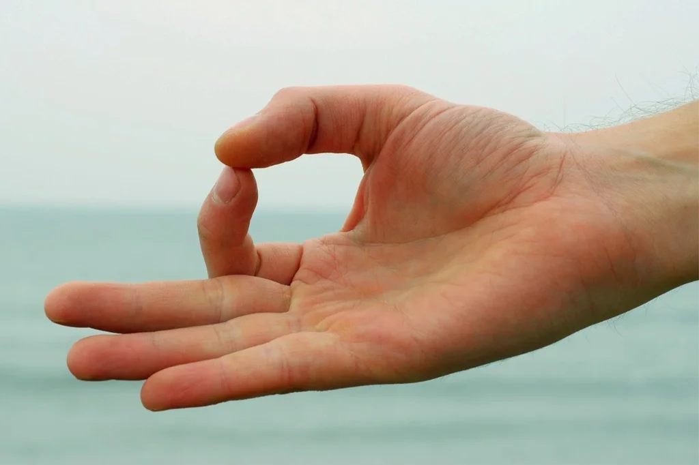
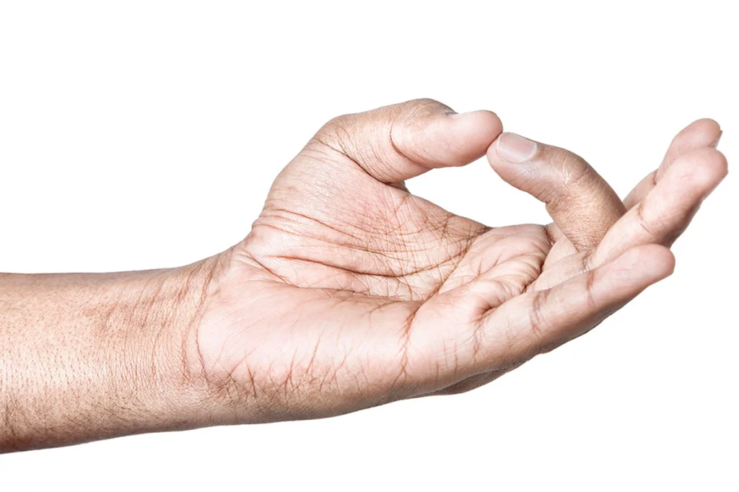
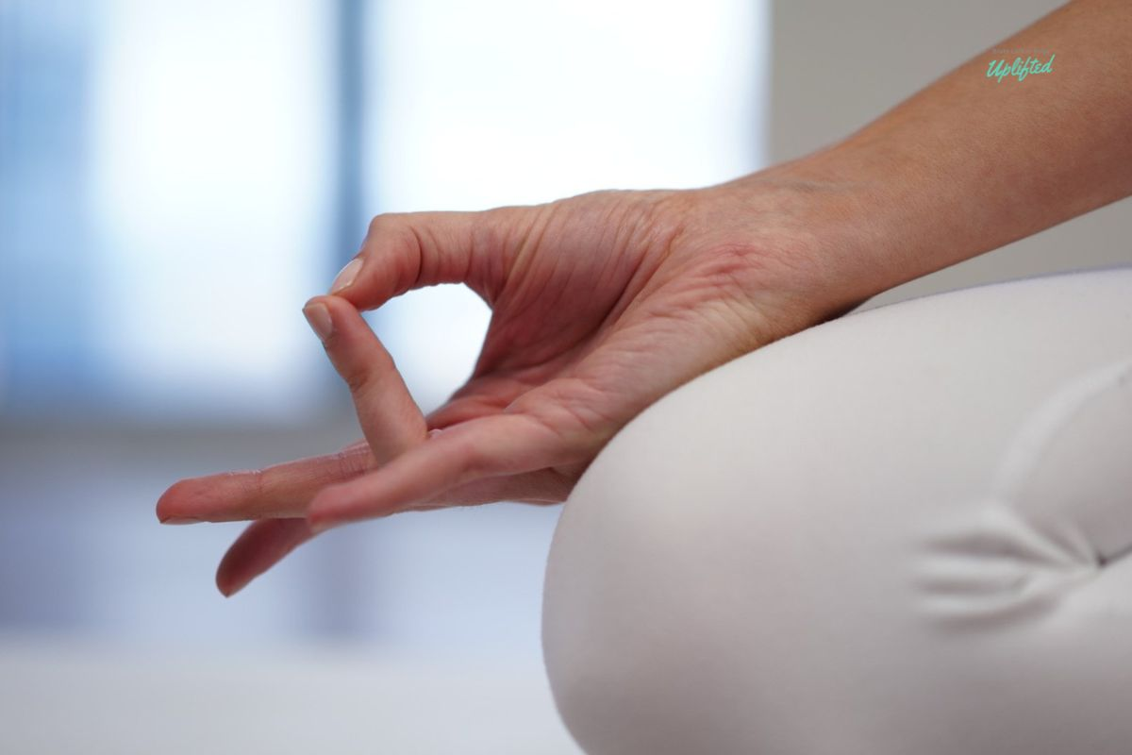
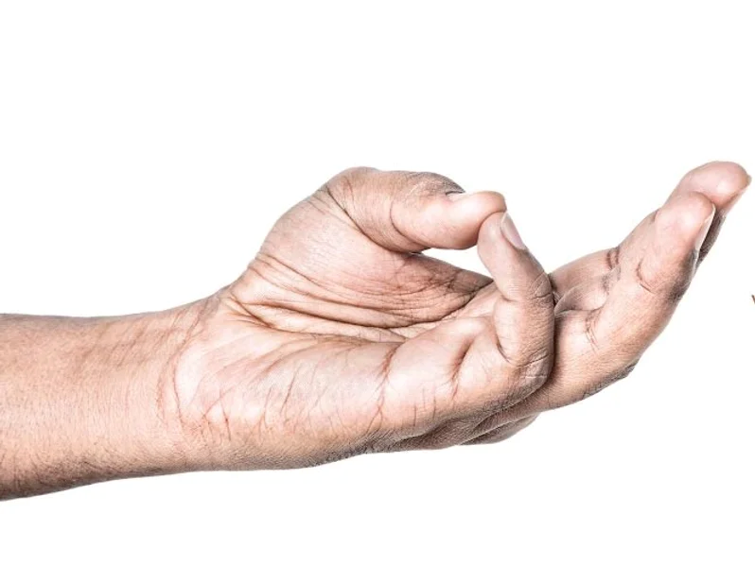
Notes:
In yogic practice, the hands are an energy map of our consciousness and health. Each area of the hand corresponds to a certain part of the body, as well as to different emotions and behaviors.
The yogis believe that hand positions formed during a kriya or meditation are a technique for communicating with the mind-body energy system. When we use these different movements, like curling, crossing, stretching, and touching the fingers and palms, we can communicate “talk” to the body and mind. This happens through stimulation of nerve endings and meridian points, and by guiding energy through specific channels.
There’s many many mudras that can be formed that are used in Kundalini Yoga and other traditions. Mudras work in tandem with yoga kriyas and meditations to create precise outcomes, such as the calming of anxiety, to breaking an old habit, confronting anger over a past hurt, and processing our emotions.¹ (“Hand Pressure Points: Everything You Need to Know”. Medical News Today.)
Common Kundalini Yoga Mudras

Slide 10
Gyan Mudra
Seal of Knowledge
Effect: Stimulates knowledge, wisdom, receptivity, and calmness.
Planet: Jupiter; expansion.
Notes:
Gyan Mudra (Seal of Knowledge)
How: Touch the tip of the index (first) finger and the tip of thumb together. The other three fingers are straight.
Effect: Stimulates knowledge, wisdom, receptivity, and calmness.
Planet: Jupiter; expansion.

Slide 11
Shuni Mudra
Seal of Patience
Effect: Promotes patience, discernment, and commitment.
Planet: Saturn; taskmaster, taking responsibility, and courage to hold to duty.
Notes:
Shuni Mudra (Seal of Patience)
How: Touch the tip of the middle (second) finger and the tip of the thumb together. The other three fingers are straight.
Effect: Promotes patience, discernment, and commitment.
Planet: Saturn; taskmaster, taking responsibility, and courage to hold to duty.

Slide 12
Seal of Sun, Life
Effect: Revitalizing energy, nerve strength and good health
Planet: Sun;
energy , health, & sexuality.
Uranus; Nerve strength, intuition & change
Surya Mudra
Notes:
Surya or Ravi Mudra (Seal of Sun, Life)
How: Touch the tip of the ring (third) finger and the tip of thumb together. The other three fingers are straight.
Effect: Revitalizing energy, nerve strength, and good health.
Planet: Sun; energy, health, and sexuality. Uranus; nerve strength, intuition, and change.

Slide 13
Buddhi Mudra
Seal of Mental Clarity
Effect: Creates capacity to clearly and intuitively communicate, stimulates psychic development.
Planet: Mercury; quickness, mental powers of communication.
Notes:
Buddhi Mudra (Seal of Mental Clarity)
How: Touch the tip of the little (fourth) finger and the tip of thumb together. The other three fingers are straight.
Effect: Creates capacity to clearly and intuitively communicate, stimulates psychic development.
Planet: Mercury; quickness, mental powers of communication.

Slide 14
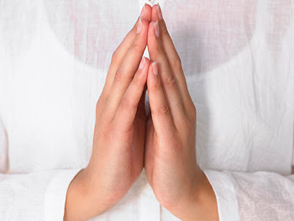
Prayer Pose
Effect: Neutralizes the positive side of the body (right, sun, masculine) with the negative side (left, moon, feminine).
Neutralizes the positive and negative polarities of the electromagnetic field and creates a neutral space.
Pranam Mudra
Notes:
Prayer Pose (Pranam Mudra)
How: The palms of both hands and fingers are completely touching. The outer edge of the mound of the thumb is pressed into the sternum.
Effect: Neutralizes the positive side of the body (right, sun, masculine) with the negative side (left, moon, feminine).
There is a science to using Prayer Pose (Pranam Mudra) because there is a polarity in the body between the right side (the pingala) and the left side (the ida). When you put the right and left hands together, you neutralize the positive and negative polarities of the electromagnetic field. This action creates a neutral space.
The position of the thumb knuckles (in the center notch of the breastbone) is a reflex point for the vagus nerve, one of the major nerves that connects with the pineal gland. The pressure created in this space during Pranam Mudra immediately causes the pineal and pituitary glands to secrete, which creates a resonance in the brain that resets its normal rhythm to a meditative state. Research on the vagus nerve has revealed that it is involved in our feelings of compassion and empathy therefore this mudra allows one’s prayer to come from the heart.

Slide 15
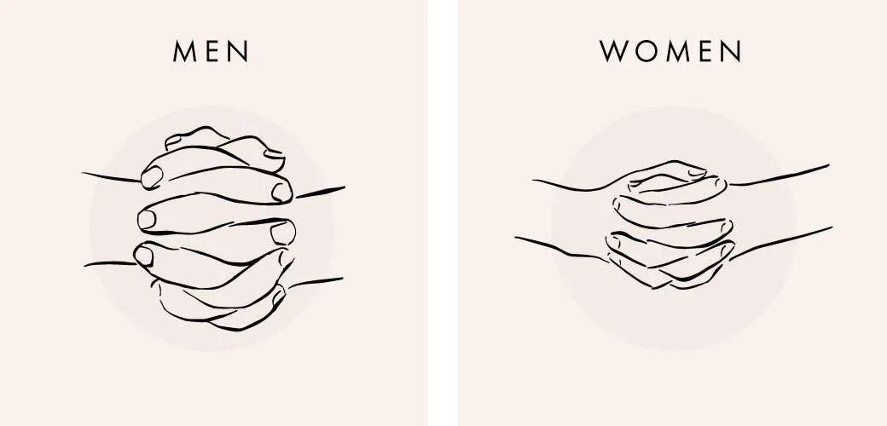
Venus Lock
Planet: The mounds at the base
of the thumbs represent Venus; sensuality and sexuality. The thumb represents the ego.
Effect: Channels sexual energy, promotes glandular balance and the ability to concentrate.
Notes:
Venus Lock
How: For masculine-identifying individuals, interlace the fingers with the left little finger on the bottom. Place the left thumb in the webbing between the thumb and index finger of the right hand. The right thumb presses the fleshy mound at the base of the left thumb. For feminine-identifying individuals, the thumb positions are reversed and the right little finger goes on the bottom.
Effect: Channels sexual energy, promotes glandular balance and the ability to concentrate.
Planet: The mounds at the base of the thumbs represent Venus; sensuality and sexuality. The thumb represents the ego.

Slide 16
Sacred Timing
3 minutes: Affects your circulation, blood chemistry and stability of the blood. The increased blood circulations begins, distributing enhanced neuroendocrine secretions throughout the body.
7 minutes: Brain patterns start to shift from the static of beta waves, to calmer alpha waves and ultimately to deep relaxing delta waves. Simultaneously, the magnetic force surrounding the body increases in strength.
11 minutes: The pituitary gland, glandular system and the nerves start to learn and change. The sympathetic and parasympathetic nervous systems begin to accommodate the increased energy.
22 minutes: Anxiety producing thoughts in the subconscious begin to clear. Your three minds (negative, positive, and neutral) start to work together so your mental integration changes. 22 is the infinite number of longing and gives mastery of the mental realm.
31 minutes: Affects your whole mind and your aura. Endocrinological balance is achieved, as is balance of the chakras of the ethereal body. This balance persists throughout the day, and is reflected by changes in moods and behavior.
Notes:
Page 135
3 minutes: Affects your circulation, blood chemistry and stability of the blood. The increased blood circulations begins, distributing enhanced neuroendocrine secretions throughout the body.
7 minutes: Brain patterns start to shift from the static of beta waves, to calmer alpha waves and ultimately to deep relaxing delta waves. Simultaneously, the magnetic force surrounding the body increases in strength.
11 minutes: The pituitary gland, glandular system and the nerves start to learn and change. The sympathetic and parasympathetic nervous systems begin to accommodate the increased energy.
22 minutes: Anxiety producing thoughts in the subconscious begin to clear. Your three minds (negative, positive, and neutral) start to work together so your mental integration changes. 22 is the infinite number of longing and gives mastery of the mental realm.
31 minutes: Affects your whole mind and your aura. Endocrinological balance is achieved, as is balance of the chakra’s of the ethereal body. This balance persists throughout the day, and is reflected by changes in moods and behavior.
2 ½ hrs: The Ancient Yogis Believed that When we give two –2½ hours, one-tenth of our day to our higher consciousness, our whole day is covered by the returning energy.

Slide 17
40 days: Helps to break negative habits that block you from the expansion possible through the Kriya or mantra, if done 40 days straight in a row
90 days: When you practice the Kriya or mantra for 90 days straight it will establish a new habit in your conscious and subconscious mind. It will change you in a very deep way.
120 days: When you commit to practice the Kriya or mantra for 120 days without skipping a day it will confirm the new habit of consciousness. The positive benefits of the Kriya get integrated permanently into your psyche.
1000 days: This will allow you to master the new habit of consciousness that the Kriya or mantra has promised. No matter what the challenge, you can call on this new habit to serve you.
Notes:
Page 135
40 days: Helps to break negative habits that block you from the expansion possible through the Kriya or mantra, if done 40 days straight in a row
90 days: When you practice the Kriya or mantra for 90 days straight it will establish a new habit in your conscious and subconscious mind. It will change you in a very deep way.
120 days: When you commit to practice the Kriya or mantra for 120 days without skipping a day it will confirm the new habit of consciousness. The positive benefits of the Kriya get integrated permanently into your psyche.
1000 days: This will allow you to master the new habit of consciousness that the Kriya or mantra has promised. No matter what the challenge, you can call on this new habit to serve you.
Short meditation: Pavan Pavan Guru

