Slide 1
MERIDIANS of the BODY
The meridian system is an energetic distribution network that moves the prana or chi through the body to support vital energetic manifestation.
There are 12 major meridians running through the body. 6 yin meridians and 6 yang meridians.
Each limb of our body has 3 of these yin and 3 of these yang meridians distributing the physical and energetic qualities of the corresponding organs or systems.
The individual meridians themselves are often described as ‘channels’ or ‘vessels’ which reflects the notion of carrying, holding, or transporting qi, blood and body fluids around the body.

Slide 2
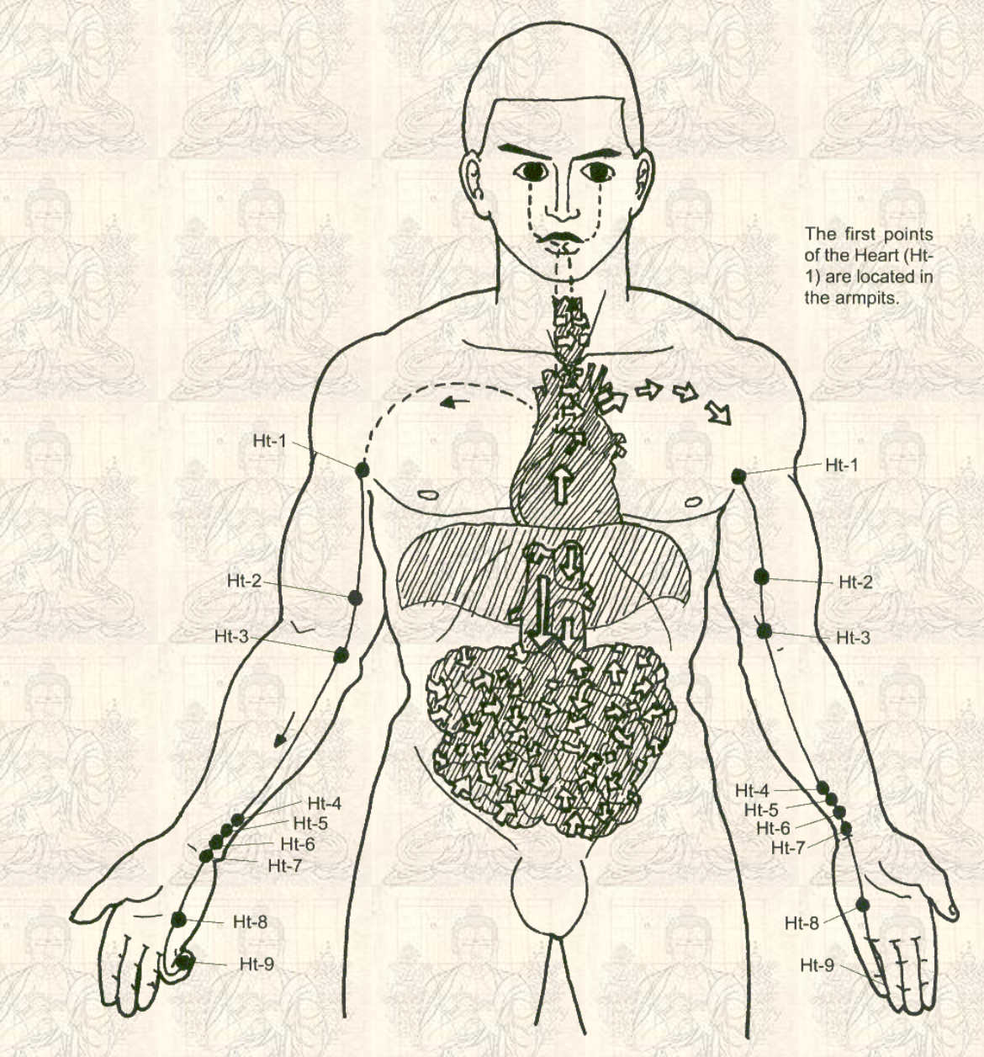
HEART - YIN
Heart - the sovereign of the organs where awareness (consciousness) originates.
Physiologically the heart controls circulation and distribution of blood. Therefore all organs depend on it. Thoughts and emotions influence the function of various organs via the pulse and blood pressure which are controlled by the heart, where emotions arise. Therefore, heart controls the emotional body.. When the heart is strong and steady, our emotions are under control. When the heart is weak and wavering, emotions rebel on the heart-mind which then loses command over the body. The Heart Meridian works to integrate the external stimuli received by the body and to affect a response. Closely connected with the thymus gland (the mainstay of the immune system). Extreme emotions such as grief, anger, panic have a suppressive effect on the immune system by inhibiting the thymus function.
Balanced Heart: Joy, Peace, Love, Contentment, Wisdom, Courtesy
Heart Imbalance /dysfunction: Hate, Guilt, Shock, Nervousness, Longing, Craving. Speech impediments, Sweaty Palms, Heart Palpitations, Irregular heart beat, excessive dreaming, poor long-term memory, despair, depression
Postures: arm extensions and movements, downward dog, full wheel, supine spinal twist, ego eradicator, aura sweeps, archer pose, cross crawls
Kriyas: To open the Heart Center, Heart Connection, Heart’s Delight, Har Aerobic Kriya, Raise Kundalini Set 2, Total Balance Kriya

Slide 3
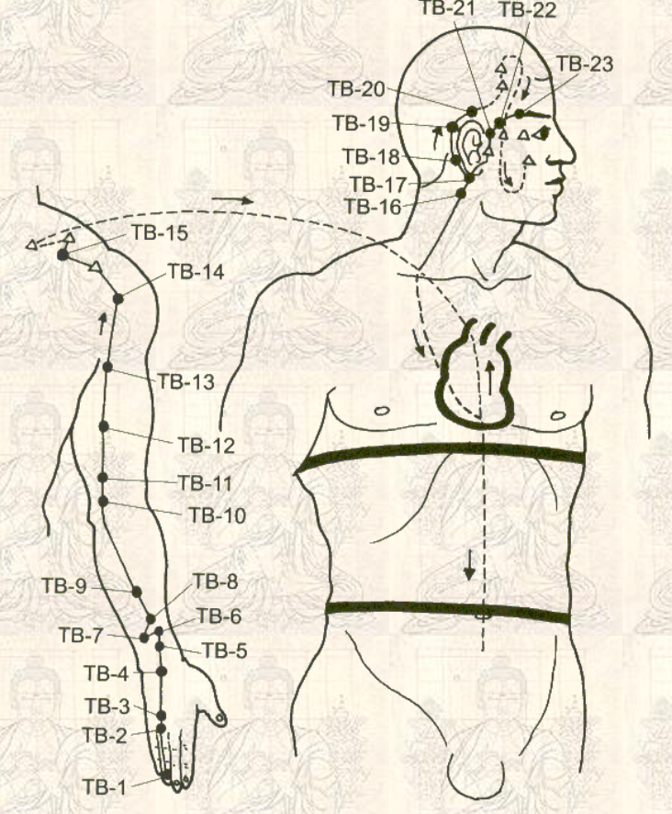
SMALL INTESTINE - YANG
The Small Intestine process nutrients out of food for use by the body. Known as the minister of reception, It assimilates and further refines the purified nutrients it worked to separate and moves the impure waste toward the large intestine for elimination. Converts food into nutrients to produce blood and tissues and to control the whole body by providing nutrition. It also aids the heart meridian by keeping the chi down in the hara to maintain composure and calmness.
Its energy meridian runs into the head, where it influences the function of the pituitary gland, the 'master gland' whose secretions regulate growth, metabolism, immunity, sexuality, and the entire endocrine system.
Strong S.I. energy: mental clarity; power of discernment.
S.I. Imbalance associated with holding things back (i.e. anger, being in a state of shock) Such mental states cause symptoms such as stagnation in neck and shoulders, fatigue, low back pains, leg cramping. Also associated with ovaries and menstrual regularity, migraine headaches.
Postures: Bow Pose, Cross Crawls, Boat Pose, Supine Spinal Twist with palms facing down, Windmills, Yoga mudra, Arm Rotations and Extensions, Neck Turns and Rolls, Shoulder Shrugs
Kriyas: Sat Kriya, Colon Cleanser, Meditation to Face the Challenge of Tomorrow, Healthy Bowel, Synchronize the Brain and the Tattvas

Slide 4
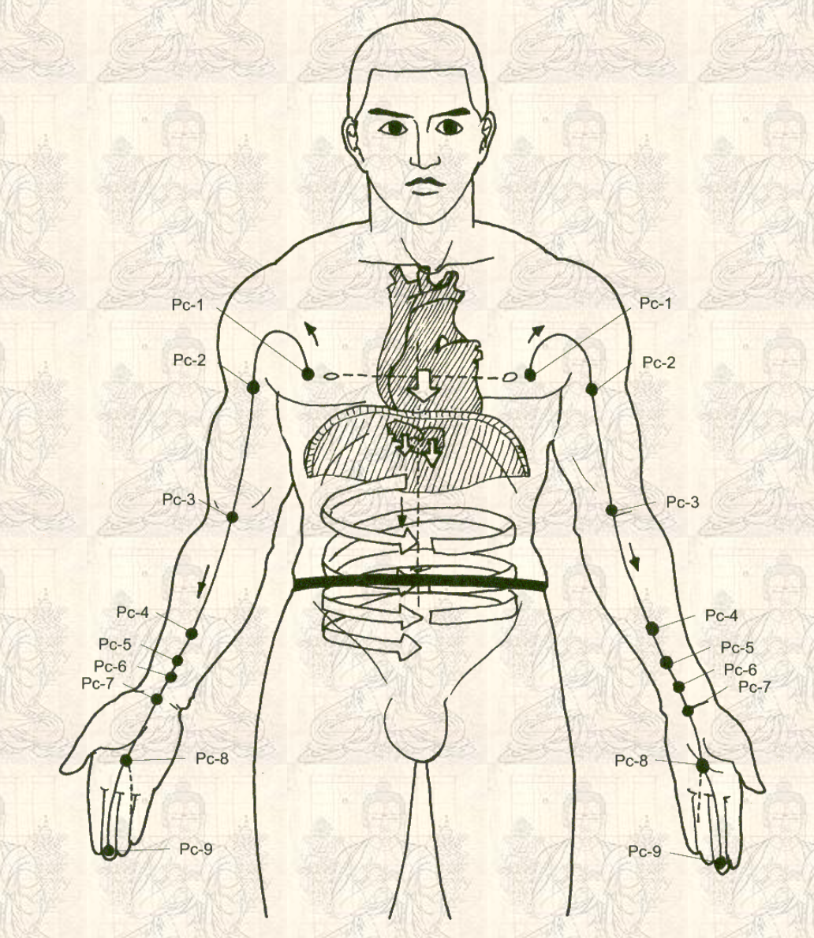
PERICARDIUM - YIN
The pericardium, or heart constrictor, conveys the will of the sovereign (the heart). Its job is to create feelings of joy and pleasure for the sovereign or king, (the heart) and to protect it.
The heart constrictor carries out the will of the heart and is involved in blood circulation which regulates the distribution of nutrients. Related to the circulatory system, the pericardium regulates circulation in the major blood vessels that run in and out of the heart.
Provides the heart with physical protection from damage and disruptions that can occur from radical fluctuations in energy caused by the emotional ups and downs of each day and the excessive emotions that other organs can generate in response.
Emotionally related to the loving feelings associated with sex, thereby linking the physical and emotional aspects of sexual activity (moderates the raw sexual en of kidneys with the all embracing love generated by the heart). Controls emotional and mental stability.
Strong Heart Constrictor energy: feelings of joy and stability.
Imbalances in the heart constrictor: exhaustion from concentrating too hard, haziness of the head, difficulty to relax, hotness of head, cold in one’s extremities, heart palpitations.
Postures and Kriyas: Same as for Heart Meridian

Slide 5
TRIPLE HEATER - YANG
The triple heater (san-jiao) regulates the actual distribution of nutrients to the extremities by its control of the peripheral circulation and lymphatic flow. It circulates the nourishing and the protecting chi (prana) into the central and peripheral part of the body. Transports the nutrients absorbed the small intestine into every corner of the body. Controls our fight and flight system.
Not an individual organ but a functional energy system that helps regulate, integrate and harmonize the activities of other organs. Known as the water minister as it is responsible for the very important role of making sure all corners of the body stay nourished and flowing.
The Upper Burner controls intake, the Middle Burner controls transformation, the Lower Burner controls elimination.
works in partnership with the pericardium. “Protection and circulation”
Related to the energy of the heart, feelings of joy from a pure space of the heart supports the harmonized and healthful flow of chi through the system, through the energy lines.
Imbalances in triple heater meridian: inability to relate well to others, feeling overly defensive, always having one’s guard up. Tense / stiff all over, clenched fists, feels cold in extremities. Susceptible to colds and flu; oversensitive to abrupt changes in environment / weather. Jing / chi depletion.
Postures and Kriyas: Same as small intestine meridian

Slide 6
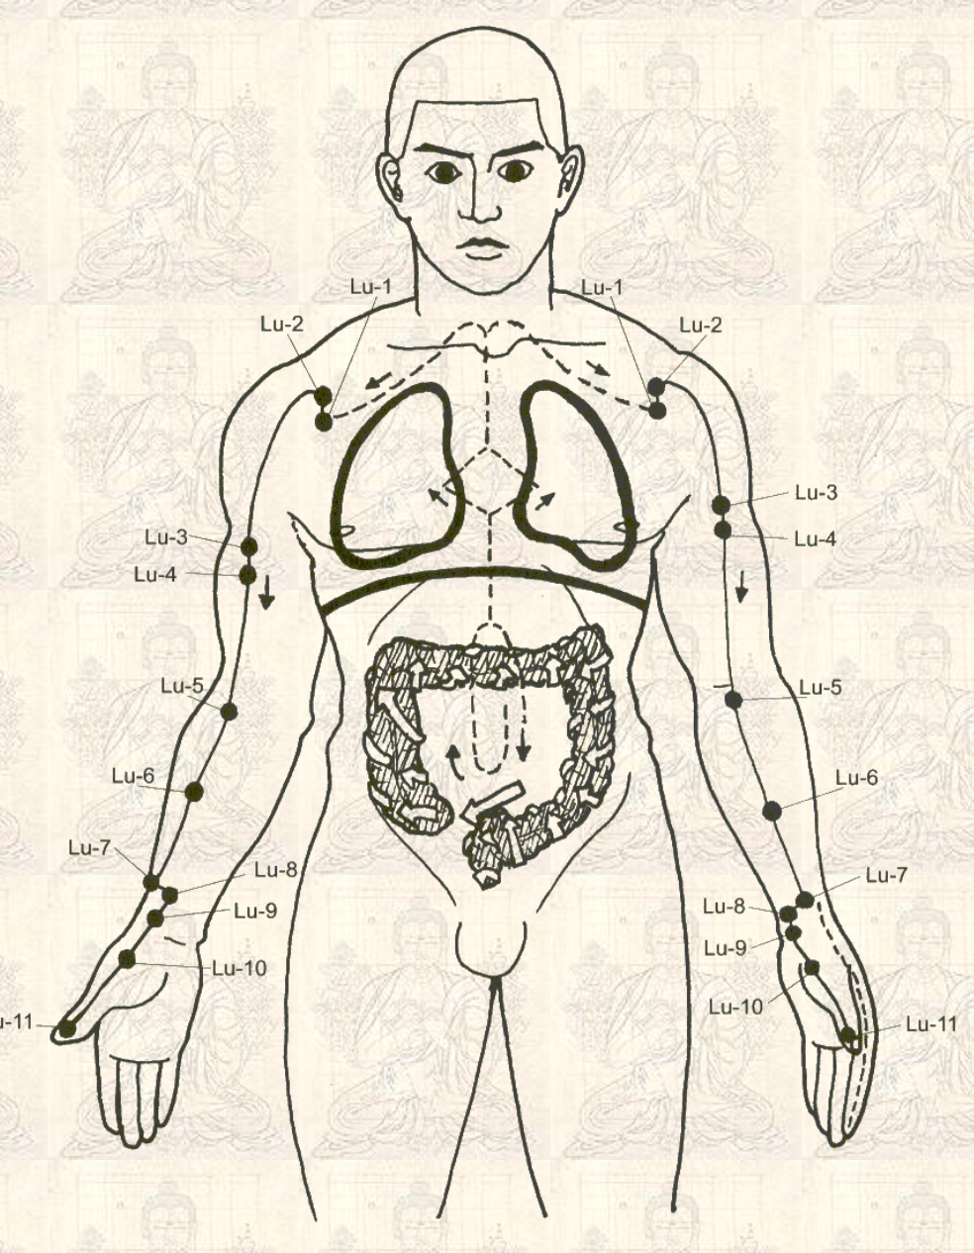
LUNGS - YIN
The lungs, known as the prime minister of the kingdom, control breath and energy and thus help the heart circulate the blood. They are responsible for managing external energies (breathing in) as well as keeping order internally (as they take in the vital prana and distribute it to activate the adaptive response of the body). This process is done through the act of breathing. This act of respiration has direct influence on one’s state of mind. Lung meridian ends at the tip of the thumb. Thus, when thumbs open, it is easier to breathe more freely.
physical branches of the vitality of the breath of the lungs: skin, nose, mucus. Also balances the autonomic nervous system.
Paired with the yang organ of the large intestines, the Lungs take in the finer essence of air while the large intestine processes grosser materials
Positive lung energy attributes: Dignity, integrity, high self esteem. Openness to life.
Imbalances in Lung meridian: lack of vigor; grief; depression. Tense neck and shoulders; heavy feeling in the head; respiratory issues; congestion of the chest.
Postures: Camel pose, boat pose, anything with arm extensions and rotations, cat cow, ego eradicator
Kriyas: New Lungs and Circulation; Lungs, Magnetic Field and Deep Meditation, Har Aerobic Kriya

Slide 7
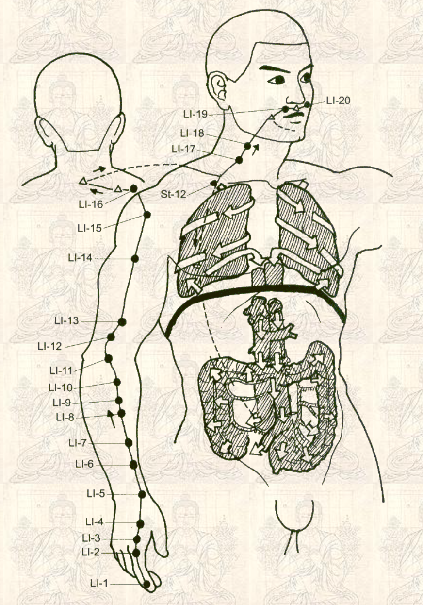
LARGE INTESTINE - YANG
The Large Intestine aids the lungs and it functions to process and eliminate food substances taken into the body. This is the action that serves to clear obstruction of chi./ prana. It helps to transmit the will of the lungs by expressing it in terms of practical action. Thus it is known as the minister of transportation of the kingdom of the body.
The LI plays a major role in the balance and purity of bodily fluids and assists the lungs in controlling the skin's pores and perspiration.
The action of the diaphragm through proper breathing links the energetic and functional aspects of the lungs and LI.
Psychologically, withholding of one’s feelings effects large intestine energy.
Imbalances in L.I. meridian: Loss of motivation, lethargy and difficulty breathing and eliminating due to lack of exercise; skin problems; constipation; diarrhea
Postures and Kriyas: Same or similar to Sm. Intestine postures and kriyas

Slide 8
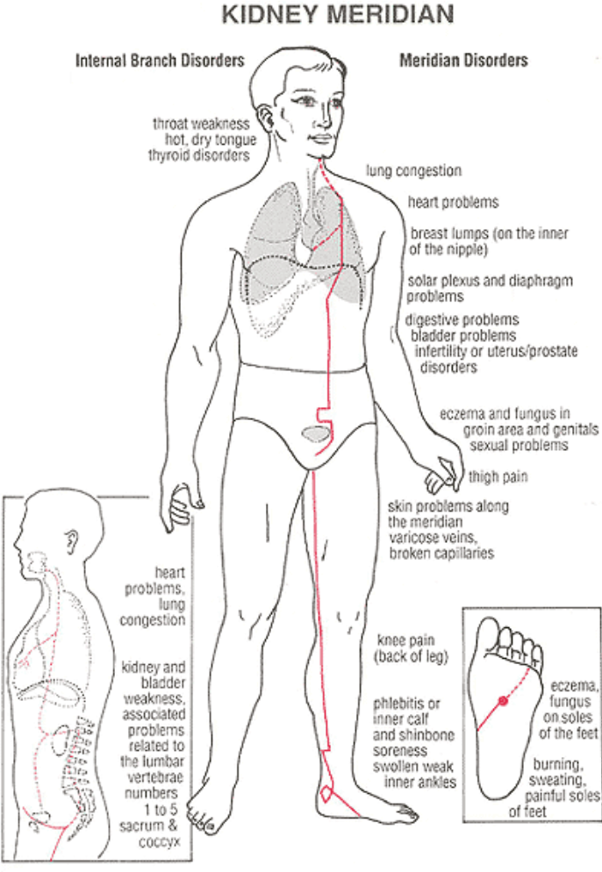
KIDNEY MERIDIAN
The kidneys are considered to control the essential energy throughout the whole body. They work to maintain a balance in body fluids, to supply all areas of the body with vital energy through hormonal regulation and to rid the body of impurities. They correlate to the adrenal glands; to one’s response to stress. The right kidney reflects the condition of the adrenals and the endocrine system. Dysfunctions in the left kidney are associated with fatigue, hotness to the head. The left kidney reflects the condition of our water metabolism. Dysfunctions of the left kidney are associated with edema and /or chilling of the extremities.
work in partnership with the bladder: vitality and purification
Strong kidney energy: wisdom, gentleness, self understanding, perseverance.
Imbalances in kidney energy: fearful; phobic; easily startled; tendency to be anxious; overwork compulsively but lack perseverance to finish what one starts. Lack of luster in the skin; edema; coldness in the lower back; nosebleeds; strong odor in the mouth.
Postures: life nerve stretch variations (legs wide), butterfly pose, spinal flexes, cat cow, pelvic lifts, all back bends, archer pose, frogs, crow squats
Kriyas: Exercise set for the kidneys, Relax and Release Fear, Toning the Kidneys, Balance Prana Apana

Slide 9
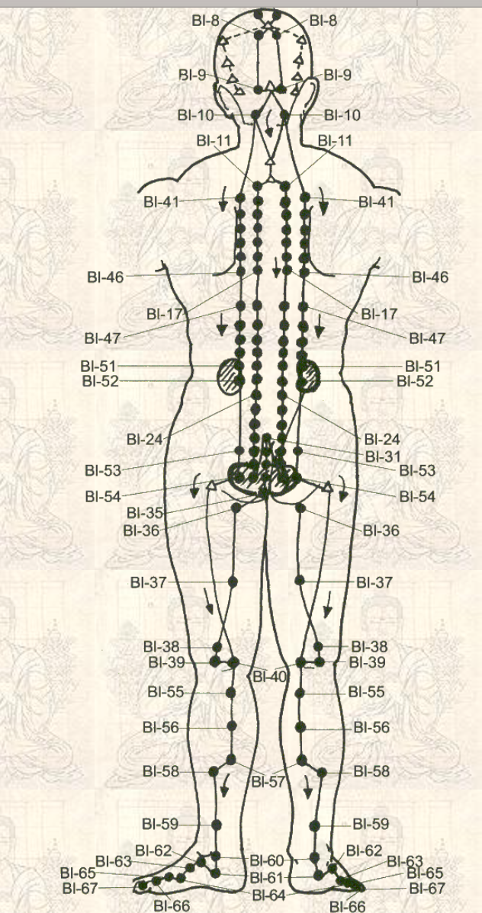
BLADDER - YANG
The function of the bladder organ is to store and eliminate the urinary waste the kidneys have passed down. The bladder meridian is closely related to the balance and functions of the autonomic nervous system as the meridians move up the entire back of the legs, the sides of the spine and up to the head. Tension and pain along the spine is relieved by stimulating flow of energy along the bladder meridian, as is bringing our nervous system into a more restful space of balance and connection.
Balanced bladder energy: calmness, ability to let go and let flow
Bladder meridian imbalances: nervous tension; overreaction; muscles of mid back become rigid and lower back area feels weak; painful sensation in the inside corners of the eyes; oppressive headaches from the back of the head to the root of the nose; chilling from lower abdomen extending through the legs causes increase or decrease in frequency of urination; cystitis; stiffness through back muscles.
Eyes, nose, teeth, reproductive organs and hair all associated with kidneys and bladder.
Postures: Life nerve stretch and variations, forward fold, cat cow, leg lifts,
Kriyas: Awaken the Diaphragm, Correct Nerve Shallowness,

Slide 10
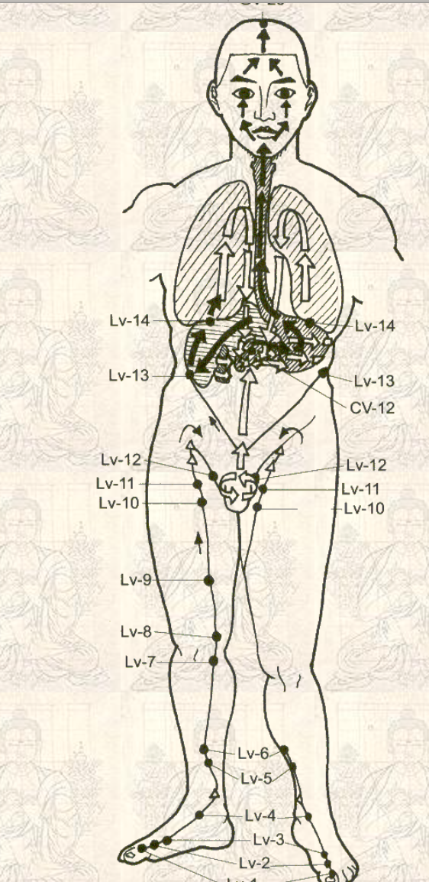
LIVER MERIDIAN
The liver works to store nutrients and secures the vital supply of energy the body needs to remain active. It also breaks down and detoxifies harmful substances. Overall function is to keep an individual full of vigor. Known as the army general who decides the strategy over how the vital energy supply of the body should be used. Known as the army general who decides strategy, the liver has command over how the vital energy supply of the body is to be used.
Works in partnership with the gallbladder: storage and distribution
Positive liver attributes: kindness, courage, generosity, vigor, energy
Liver energy imbalance: loss of vitality, sudden spurts of motivation followed by extreme fatigue; bad temper; anger; dizziness upon standing; yellowish tinge to the eyes; prostate / testicle problems; lower back pain
Kriyas: Let the liver live. Kriya for the liver, colon and stomach
Postures: Butterfly pose, Life nerve stretch variations, Leg lifts,anything that stretches inner thigh

Slide 11
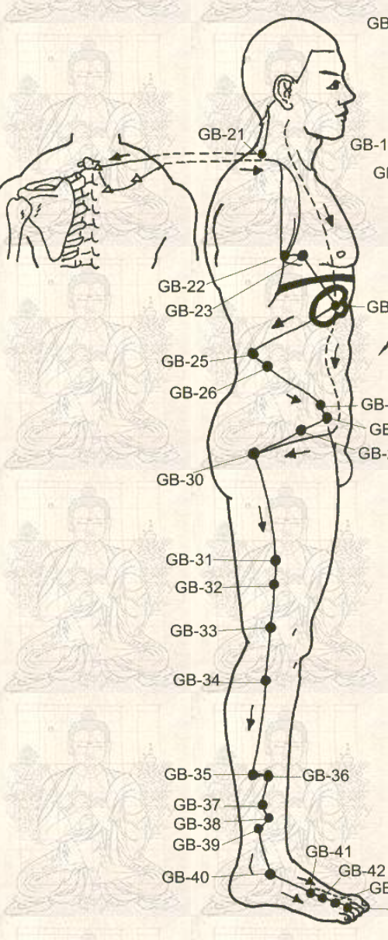
GALLBLADDER - YANG
The gallbladder controls the distribution of nutrients throughout the body and controls the amount and balance of digestive enzymes. Secretes potent bile fluids required to digest fats and oils. Its energy provides muscle strength and vitality. Strong gallbladder chi eliminates muscle aches and fatigue by working with the lymphatic system. Works as well with hormones from the thyroid and parathyroid. Associated with endocrine system.
Known as the Honorable Minister, the gallbladder provides the capacity to turn the drive and vitality of the kidneys and the strategy of the liver into decisive action. Has influence on quality and length of sleep.
Positive gallbladder energy attributes: Daring; Decisiveness; Courage; Initiative
Gallbladder imbalance: overly concerned with details, losing sleep over inability to make decisions, timid, easily discouraged by slight adversity. Eye strain, blurry eyes, yellowing of the eyes. People with gb imbalance may not take the time to eat properly so they will not produce sufficient bile for digestion and will have constipation or diarrhea. Stiffness in joints. Distended stomach.
Postures: Side Bends, Pigeon Pose, Leg scissors, Spinal twist, Cat Stretch, One legged life nerve stretch, butterfly pose, sitting to standing repetitions, frogs
Kriyas: A sweet kriya to get the energy moving, Kriya for Liver, Colon, Stomach

Slide 12
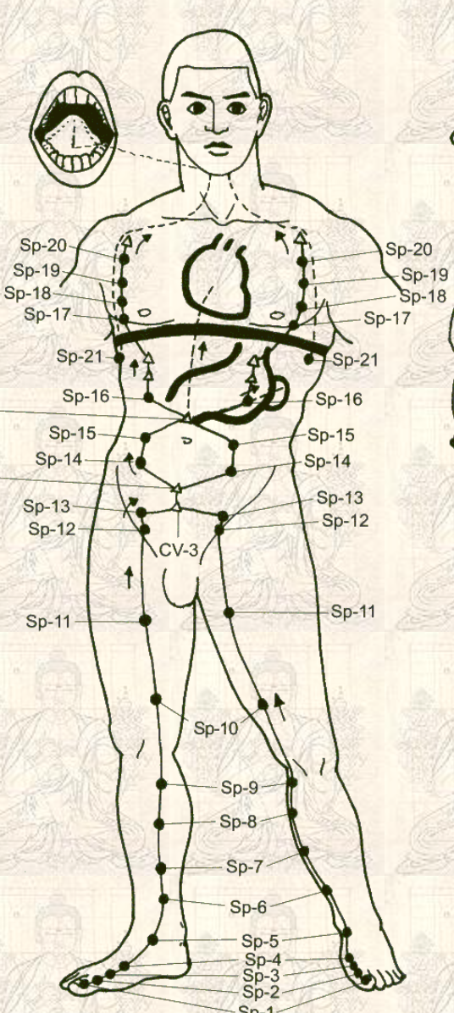
SPLEEN - YIN
Spleen meridian includes the pancreas and all the organs which secrete digestive enzymes. As minister of the granary, the Spleen transports nutrients and produces and regulates blood. It is responsible for the transformation of food into nourishment. Also relates to reproductive glands in women(mammaries, ovaries). The spleen houses the body’s thoughts and intentions. It is related to cognition, analytical thinking and memory. It directly influences and is reflected by muscle tone.
Stomach receives food, digests, and spleen transports the nutrients. Stomach moves things down, spleen distributes chi upwards. The spleen also regulates the balance of water thru the body with the kidneys. It affects the lymphatic system as well as muscle tone.
Positive, balanced spleen energy: openness; trust; balance; acceptance; equanimity.
Insufficient spleen energy: excessive thinking; worrying; self doubt; constant craving of food, especially sweets , therefore often eating between meals and getting drowsy often; flatulence; water imbalance, bloating, excessive phlegm. Associated also with shoulder dysfunction, which can lead to frozen shoulder. Weak limbs and muscular atrophy are also signs of deficient spleen energy
Dampness and cold hinders spleen energy from its transformational and transporting functions, which can lead to great disturbances in the water balance of the body, causing phlegm.
Kriyas: maintain the spleen, balance prana and apana, nabhi kriya for digestion.

Slide 13
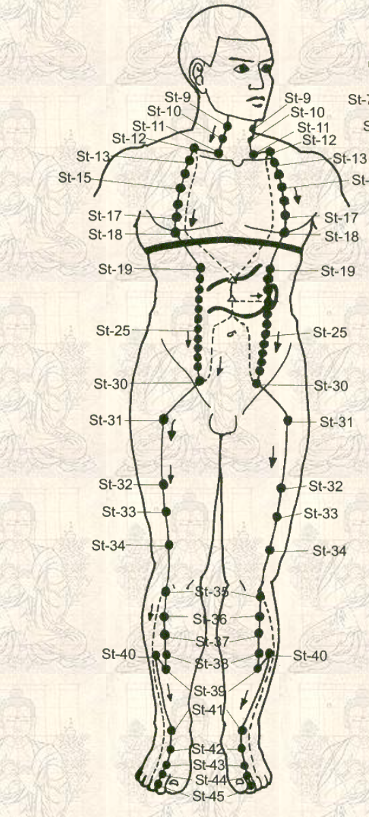
STOMACH - YANG
Stomach energy is energy of digestion (mostly upper digestive tract). Begins at the mouth, involves the jaws, esophagus, trachea, stomach, down to the small intestine. The stomach, in facilitating the functioning of these parts, relates to eating, exercising, production of body heat, reproduction for women. Controls appetite, lactation and functioning of the ovaries to some extent. Responsible for providing the entire system with postnatal energy from the digestion of foods and fluids and from moving them on to the small intestine for extraction and assimilation of nutrients.
Minister of the mill – of nourishment. Muscles, mouth, lips and saliva are the phsyical tissues correlated with the stomach and spleen.
Balanced stomach energy: equanimity. Balanced mental state
Imbalance in stomach meridian: tendency to worry over minor details, agitation in the mind, tension build up in neck and shoulders. Legs can feel heavy, feet can feel cold. Tired, yawning a lot. Can have a tendency to overeat. Sores at the mouth are symptoms of stomach energy insufficiency.
Postures: rock pose, sat kriya, spinal flexes, cat cow, camel, bow pose, leg lifts, stretch pose,
Kriyas: Nabhi, Nabhi Prana Apana, Nabhi Kriya for Digestion, Strengthening the Stomach Balance Prana and Apana, All kriyas for nabhi / digestion, Kriya for the Liver, Colon, Stomach

